Slide 1
Alcoa, Anti-Trust, and the Industrial Economy
I. The Rise of Big Business
A. Economies of Scale
B. Vertical Integration at Carnegie Steel
C. Horizontal Integration at Standard Oil
D. Political Response
1. Sherman Anti-Trust Act of 1890
II. The Alcoa Story
A. The Smelting Challenge
1. Charles Martin Hall
B. The Pittsburgh Reduction Company (188-1907)
C. The Aluminum Company of America
1. early production
2. product design
3. vertical integration
III. The Alcoa Monopoly?
A. the Aluminum Research Laboratory
B. Anti-Trust Prosecution
1. initial decision (1942)
2. appeal (1945)
3. breakup
C. the “splendid retreat”
IMOS
Intended for classroom instruction only.
Do not circulate.

Slide 2
Sales Outlets
Finished Products
Structural Steel, Rails, Etc.
Steel Ingot Production
Vertical Integration
at
Carnegie Steel
Pig Iron Production
Raw Materials
Iron ore, Coal, Limestone, Etc.
IMOS
Intended for classroom instruction only.
Do not circulate.

Slide 3
Consumers of Distilled Products
(Kerosene, Petroleum, Etc.)
Company A:
Refining
Standard Oil:
Refining
Company B:
Refining
IMOS
Intended for classroom instruction only.
Do not circulate.
Independent Crude Oil Producers

Slide 4
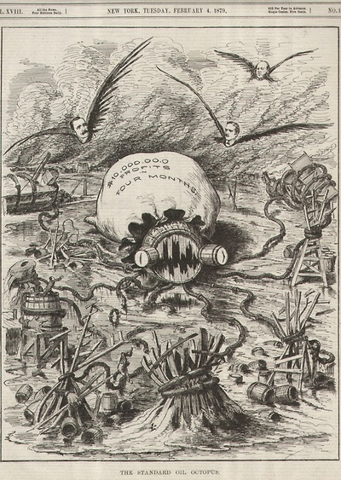
IMOS
Intended for classroom instruction only.
Do not circulate.

Slide 5
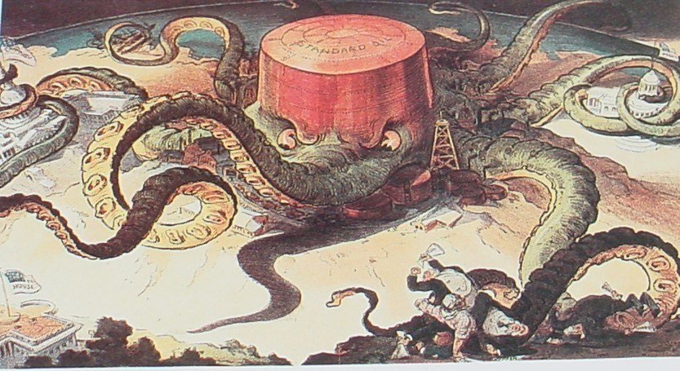
IMOS
Intended for classroom instruction only.
Do not circulate.

Slide 6
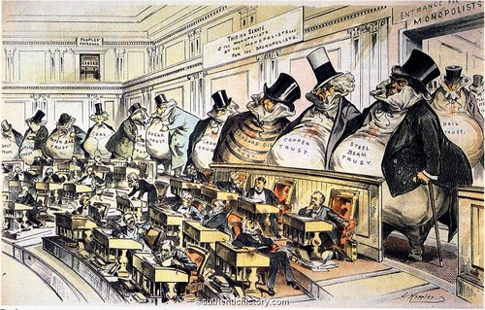
1889
IMOS
Intended for classroom instruction only.
Do not circulate.

Slide 7
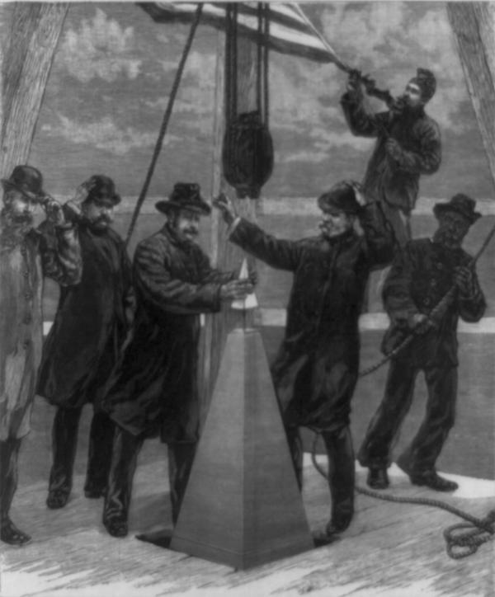
IMOS
Intended for classroom instruction only.
Do not circulate.
1884

Slide 8
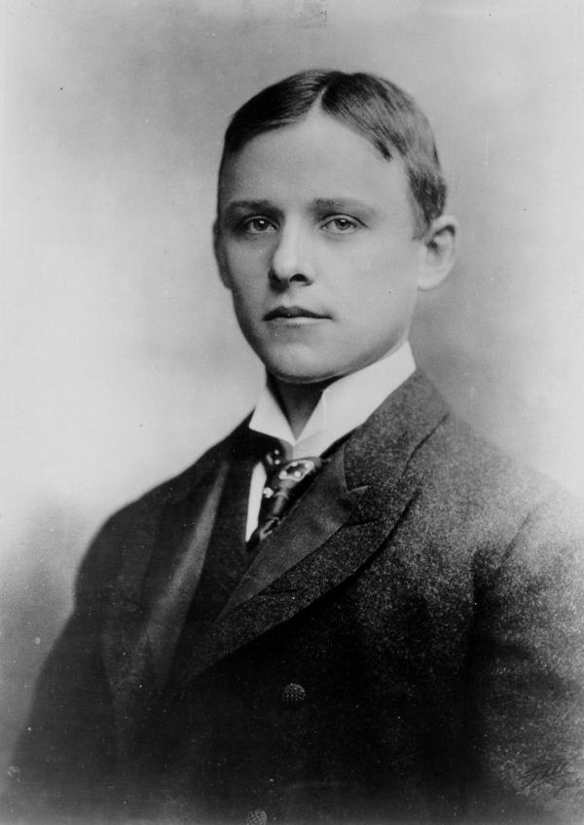
IMOS
Intended for classroom instruction only.
Do not circulate.
Charles Martin Hall, 1885

Slide 9
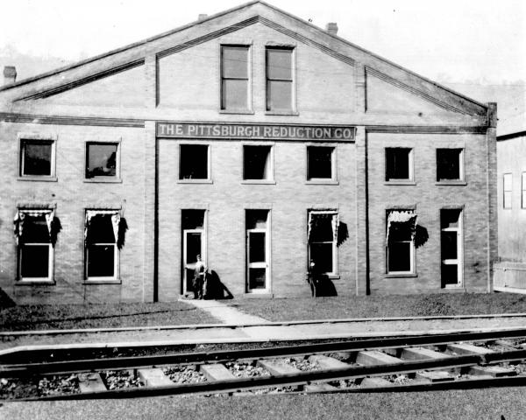
IMOS
Intended for classroom instruction only.
Do not circulate.
1890

Slide 10
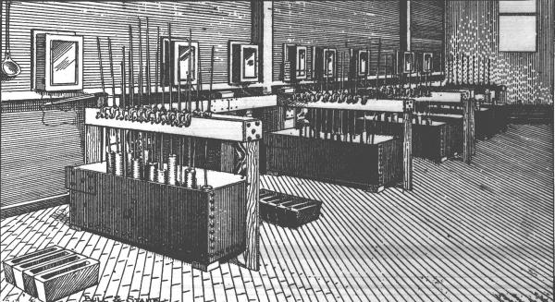
IMOS
Intended for classroom instruction only.
Do not circulate.
Pittsburgh Reduction Company’s Cell Room, 1886

Slide 11
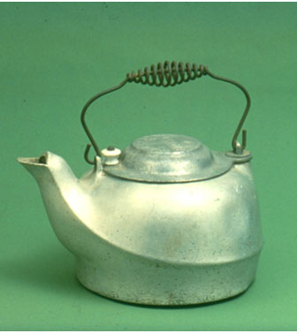
1889
IMOS
Intended for classroom instruction only.
Do not circulate.

Slide 12
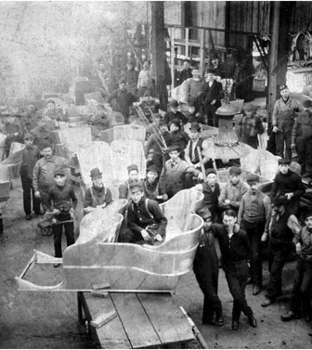
IMOS
Intended for classroom instruction only.
Do not circulate.
1901

Slide 13
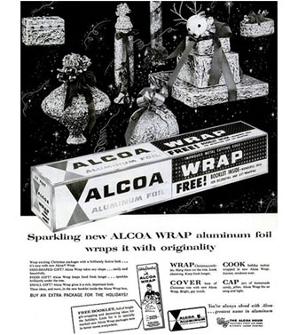
IMOS
Intended for classroom instruction only.
Do not circulate.

Slide 14
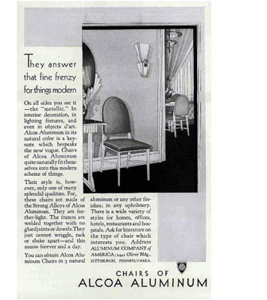
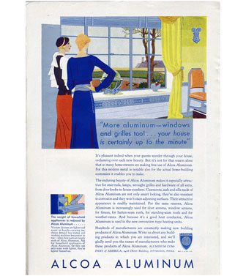
1922
IMOS
Intended for classroom instruction only.
Do not circulate.
1928

Slide 15
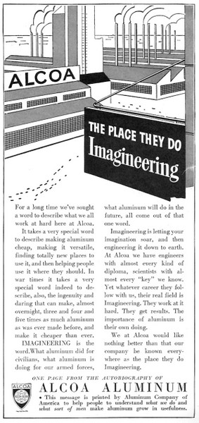
IMOS
Intended for classroom instruction only.
Do not circulate.
1942

Slide 16
US Estimates of Alcoa Market Share, 1940
Product | Percentage Produced by Alcoa
Bauxite Production for Aluminum | 100
Alumina | 100
Aluminum, Primary | 100
Sheet Aluminum | 60
Extruded Shapes | 40
Forgings | 60
Tubing, Rod, Wire, and Bar Aluminum | 60
Aluminum Foil | 50
Aluminum Pistons | 22
Cooking Utensils | 50
IMOS
Intended for classroom instruction only.
Do not circulate.
Source: Smith, From Monopoly to Competition, p. 200

Slide 17
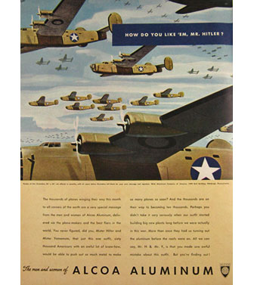
IMOS
Intended for classroom instruction only.
Do not circulate.
1943

Slide 18
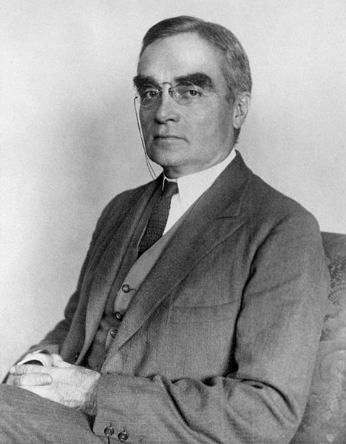
IMOS
Intended for classroom instruction only.
Do not circulate.
Justice Learned Hand

Slide 19
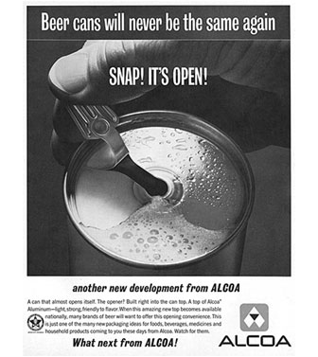
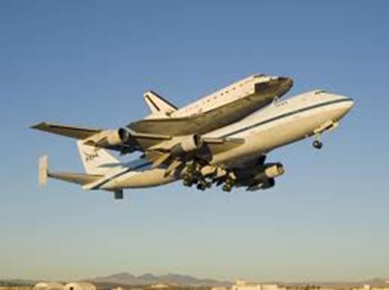
IMOS
Intended for classroom instruction only.
Do not circulate.
1962

