Slide 1
Advanced or technical ceramics
Can take many forms:
Multifunctional Ceramics
Ferroelectrics
Conductive Ceramics
Dielectric Ceramics
Magnetic Ceramics
Etc.
IMOS
Intended for classroom instruction only.
Do not circulate.

Slide 2
Advanced or technical ceramics
Can take many forms:
Multifunctional Ceramics
Ferroelectrics
Conductive Ceramics
Dielectric Ceramics
Magnetic CeramicsEtc.
IMOS
Intended for classroom instruction only.
Do not circulate.

Slide 3
Multifunctional Ceramics
IMOS
Intended for classroom instruction only.
Do not circulate.
Methods of Transducing Energy

Slide 4
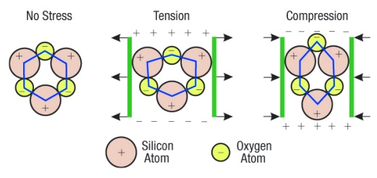
How do they work?
Use the crystal structure to facilitate the transducer action: E.g. piezoelectric Quartz
IMOS
Intended for classroom instruction only.
Do not circulate.
Application of stress induces a positive and negative side to the crystal. This electric filed can be very large e.g. thousands of volts
http://paganpath.com/study/academy/crystals/347-2

Slide 5
Multifunctional Ceramics
IMOS
Intended for classroom instruction only.
Do not circulate.
Other possibilities exist but at very inefficient (e.g. electrocaloric record is <12°C/480V/cm)

Slide 6
Advanced or technical ceramics
Can take many forms:
Multifunctional Ceramics
Ferroelectrics
Conductive Ceramics
Dielectric Ceramics
Magnetic Ceramics
Etc.
IMOS
Intended for classroom instruction only.
Do not circulate.

Slide 7
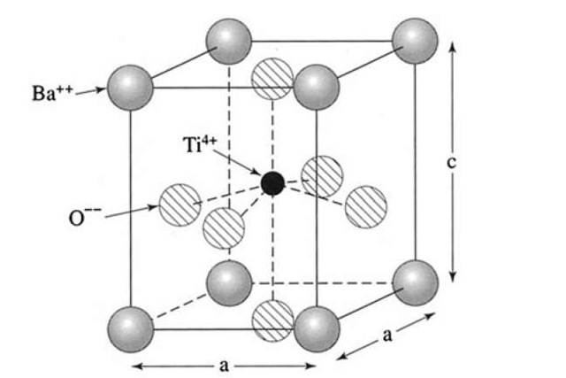
What other forms of these functional ceramics exist
Ferroelectrics
Display a permanent polarization after electric field is removed.
Way of storing information
Used in the chip for your smartcard
Examples include BaTiO₃
IMOS
Intended for classroom instruction only.
Do not circulate.
http://cmt-stl.org/bringing-smart-cards-to-the-region/
http://what-when-how.com/electronic-properties-of-materials/electrical-properties-of-polymers-ceramics-dielectrics-and-amorphous-materials-part-3/

Slide 8
Advanced or technical ceramics
Can take many forms:
Multifunctional Ceramics
Ferroelectrics
Conductive Ceramics
Dielectric Ceramics
Magnetic Ceramics
Etc.
IMOS
Intended for classroom instruction only.
Do not circulate.

Slide 9
Conductive Ceramics
Transparent conductive oxides
Display a high electrical conductivity
Are transparent in the visible regime
Critical to flat panel displays, TV’s, IPhones, solar cells
Examples include Indium Tin Oxide (ITO)
Less expensive alternative is Aluminum Zinc Oxide (AZO)
IMOS
Intended for classroom instruction only.
Do not circulate.
http://bizbeatblog.dallasnews.com/tag/head-up-display/

Slide 10
Advanced or technical ceramics
Can take many forms:
Multifunctional Ceramics
Ferroelectrics
Conductive Ceramics
Dielectric Ceramics
Magnetic Ceramics
Etc.
IMOS
Intended for classroom instruction only.
Do not circulate.

Slide 11
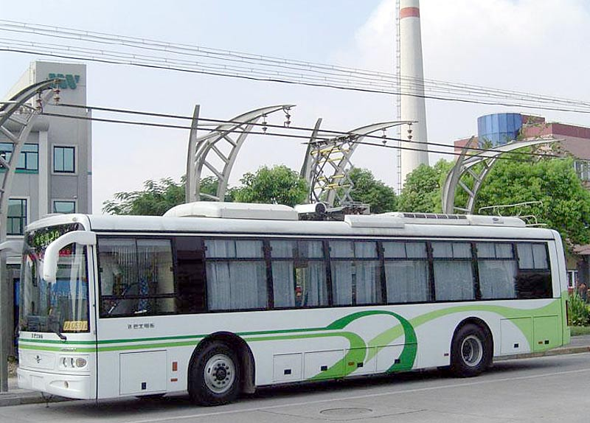
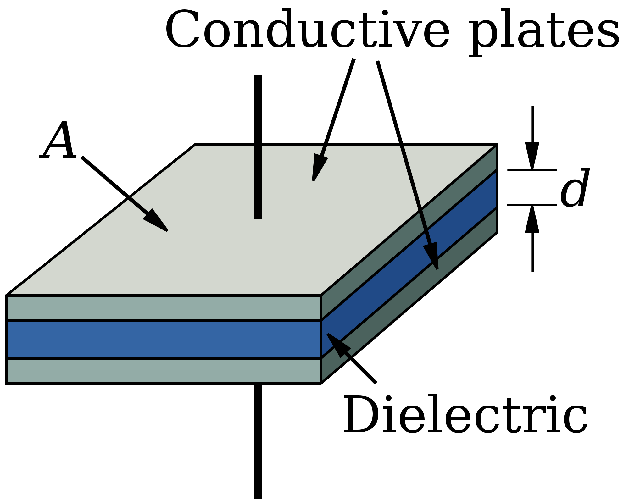
Dielectric Ceramics
Used to store electrical charge
Unlike a battery the discharge is very rapid
The ability to store charge is both materials and structure dependent
Used in all circuits, Powering Transportation
IMOS
Intended for classroom instruction only.
Do not circulate.
Ceramic layer
Charge capacitor at each bus stop
http://citytransport.info/Electbus2.htm
https://en.wikipedia.org/wiki/Polymer_capacitor

Slide 12
Advanced or technical ceramics
Can take many forms:
Multifunctional Ceramics
Ferroelectrics
Conductive Ceramics
Dielectric Ceramics
Magnetic Ceramics
Etc.
IMOS
Intended for classroom instruction only.
Do not circulate.

Slide 13
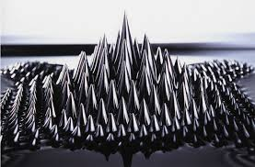
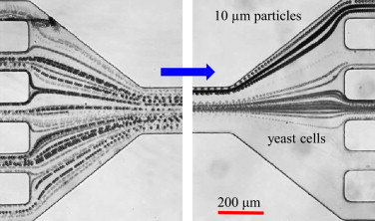
Magnetic Ceramics
Lots of examples like superconductors, giant magntoresistance
E.g. Ferrofluids : Fe₃O₄ or other magnetic oxides nanoparticles
Average particle size 10nm with stabilizing surfactant
Used for vacuum seals in space
Examples of possible future uses include:
cancer treatments
microsatellite propulsion
IMOS
Intended for classroom instruction only.
Do not circulate.
http://fractalenlightenment.com/14637/artwork/fractal-sculptures-with-magnetic-ferrofluid
Jian Zeng et al Journal of Magnetism and Magnetic Materials, Volume 346, 2013, 118–123

Slide 14
Summary
Technical or functional ceramics can take many forms
Multifunctional Ceramics, Ferroelectrics, Conductive Ceramics, Dielectric Ceramics, Magnetic Ceramics, etc.
These materials require a number of steps in their operational chain of fabrication
These range from mining/purchasing the raw materials, transportation, material preparation, processing of materials (synthesis, deposition etc.), scale up and yield improvement, distribution, intensification
There are both scientific an social challenges associated with each step
IMOS
Intended for classroom instruction only.
Do not circulate.

