Slide 1
Ceramics and Glass
https://www.youtube.com/watch?v=tPd1GIwjRFM

Slide 2
Ceramic/Glass
Describe a Ceramic?
Describe a Glass?

Slide 3
Ceramic
Inorganic, nonmetallic solid
Metal, nonmetal or metalloid atoms primarily held in ionic and covalent bonds
Brittle, high melting point, poor conductor, stiff, chemically resistant, waterproof
Crystallinity varies from crystalline to semicrystalline to amorphous

Slide 4
Glass
Inorganic, nonmetallic solid
Metal, nonmetal or metalloid atoms primarily held in ionic and covalent bonds
Brittle, high melting point, poor conductor, chemically resistant, waterproof
Crystallinity: Does not exist i.e. its amorphous also considered a frozen liquid

Slide 5
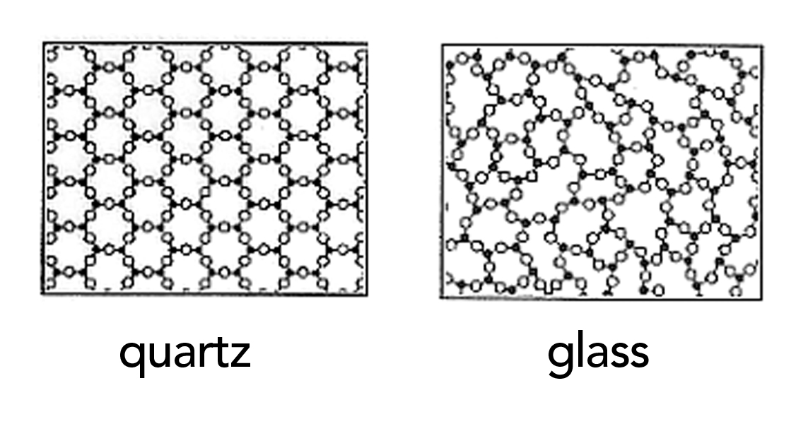
Structure
Crystalline Amorphous
http://www.cmog.org/article/what-is-glass

Slide 6
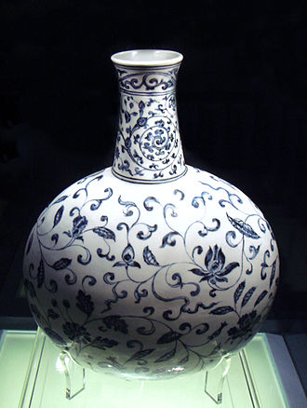
Ceramics
Ceramic comes from Keramos (Greek for pottery)
Early forms of ceramics were formed by the heat treatment of Clay
E.g. Kaolinite clay after firing above 1000°C forms Porcelain a ceramic
Other forms include
Earthenware
Stoneware
Bone China
A Ming Dynasty porcelain vase dated to 1403–1424
https://upload.wikimedia.org/wikipedia/commons/thumb/4/4f/Blue_and_white_vase_Jingdezhen_Ming_Yongle_1403_1424.jpg/330px-Blue_and_white_vase_Jingdezhen_Ming_Yongle_1403_1424.jpg

Slide 7
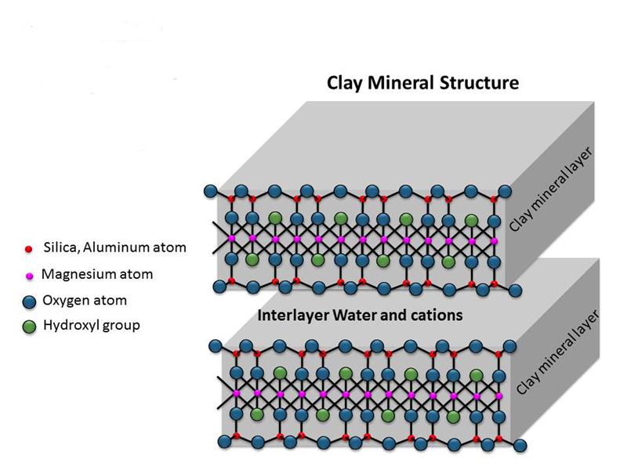
Clay structure
Properties:
With water layers can slide past each other
→ plasticity
Upon drying the clay it will harden but no chemical reaction is induced → sundried bricks
Upon firing (>1000°C) can induce chemical bonding of the layers
(formation of Si-O-Si bonds) → Ceramics
Aluminum or Magnesium)

Slide 8
Ceramics
Another type of ceramic is called a Technical Ceramic
Oxides
Quartz (SiO₂), Alumina (Al₂O₃), Ceria (CeO₂), Zirconia (ZrO₂)
Nonoxides
Carbide (e.g. SiC), Nitride (e.g. Si2N4), Silicide (e.g. TiSi2), Boride (Nd₂Fe₁₄B)
Functional Ceramics
Electroactive, multiferroic, piezoelectric ceramics
Materials that can convert energy from one form to another or respond in unusual ways to external stimulai (subject of the video)

Slide 9
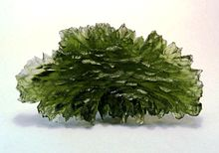
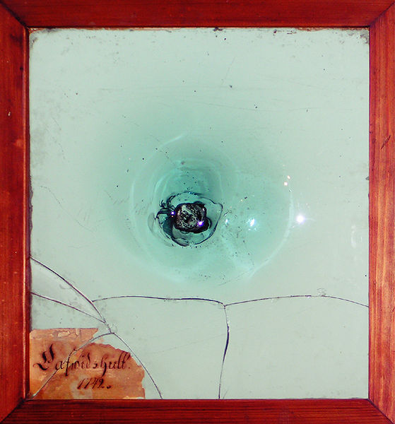
Glass
https://anjouclothing.files.wordpress.com/2013/01/7.jpg?w=640
Lets focus on one subset of ceramics ie traditional Glass (leave metallic Glass for later)
Glass is an Amorphous solid
Forms:
Oxides, Borides, Polymers even Metals
Most common glasses are based on SiO₂
Moldavite, a natural glass formed by meteor impact, from Besednice, Bohemia
https://s-media-cache-ak0.pinimg.com/236x/cb/e8/6f/cbe86f708b15d1a2c549503c2ba6f5ee.jpg
This course contains copyright materials that are used solely for instructional purposes within this course. Copying, printing or distribution for other purposes is prohibited.
Oldest mouth-blown window-glass in Sweden (Kosta Glasbruk, 1742)

Slide 10
SiO₂
Si
Glass is amorphous ie structure is random in long range
It is inherently unstable so it will crystallize with time (called vitrification)
Melts at 1713°C very high
Given a fire gets no more than 1000°C how did we ever get to develop it?
Si
O
O
Si
O
O
Si
Si

Slide 11
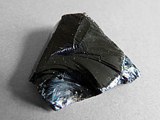
Earliest Forms
Obsidian
Volcanic Glass
Didn’t need a fire
Used extensively for spearpoints
https://upload.wikimedia.org/wikipedia/commons/thumb/1/17/Lipari-Obsidienne_(5).jpg/225px-Lipari-Obsidienne_(5).jpg

Slide 12
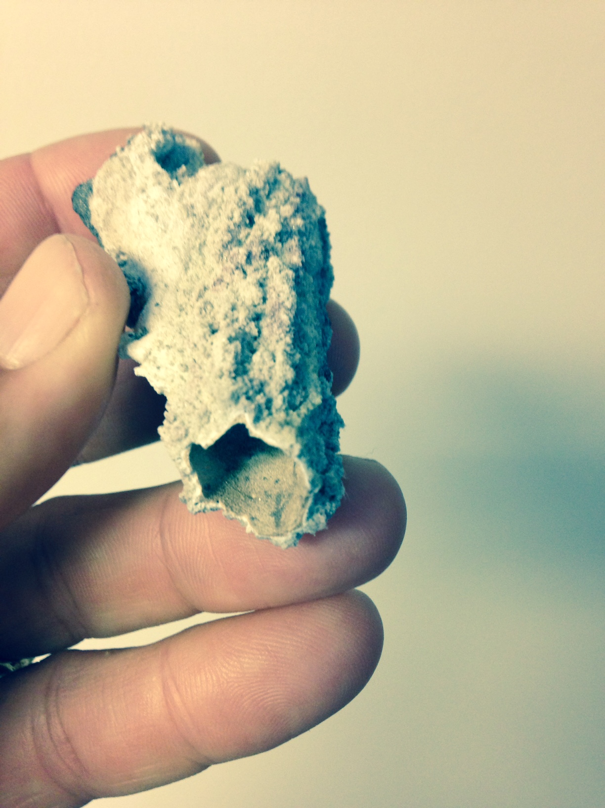
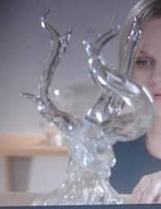
What about lightning made Glass?
Fulgurites look like this
This is Hollywood’s version
Sweet Home Alabama
http://slckismet.blogspot.com/2013/03/who-could-have-predicted-that-sweet.html

Slide 13
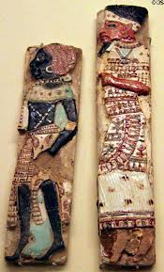
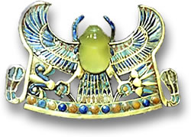
History Egypt
King Tutankhamun’s Glass Scarab
Ancient Egyptian faience & glass palace inlays showing Nubian & Philistine slaves (1182-1151 BCE) from Thebes at Museum of Fine Arts. Boston, MA.
Desert Glass was 26M years old so most likely came from a meteorite
http://www.gemselect.com/other-info/king-tuts-tomb-of-treasures.php
http://travelphotobase.com/v/USMAB/MAAF2141.HTM

Slide 14
What made glass making possible?
The Faience was made by using Nile sediment
This contained Natron (NaCO₃)
Sodium is a network modifier
Melts at 850°C and reacts with SiO₂
Lower the melting point of glass significantly
Sodium Silicate glass dissolves in water
Add Lime (CaO) to strengthen the network
Thus the invention of Soda lime glass (still used today)

Slide 15
Brief History
Around 3000BC faience glazes were used
As fires got hotter one gets more complete reaction
Around 1600BC glass workers started making core wound vessels
By 1500BC glass was in western Asia, Crete, Egypt and Greece
900-600BC new methods in Greece
Slump Glass and Thousand Flower method
By 100BC glass blowing is developed in Syria /Palestine area
Made glass inexpensive
Roman Conquest took technology back to Rome

Slide 16
Roman Glass
Romans loved Glass
Made clear colorless glass in Alexandria ~100AD through addition of MnO₂
Drinking vessels
One of the first times you could see what you were drinking
Contributed to appreciation of wine
Made first windows
Made first mirrors

Slide 17
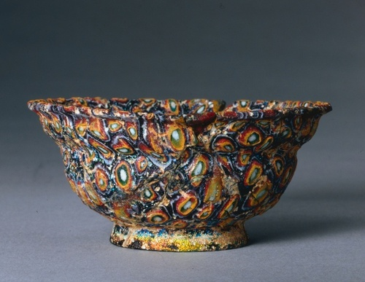
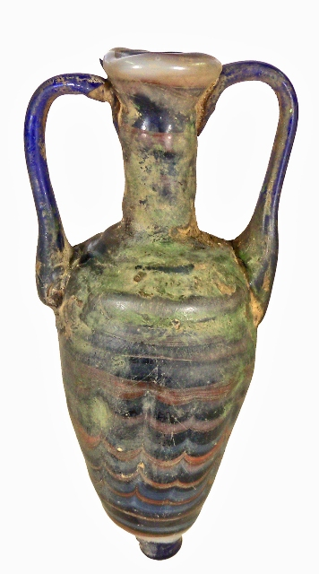
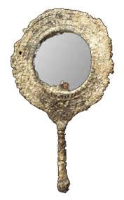
History Phoenicia and Rome
1-100AD Milefiori Roman thousand flower bowl
400-200BC Phoenician Core wound Vessel
Roman Mirror
http://mjgrafx.8m.com/Welcome%20to%20Ruby's%20World/RUBYSVILLE/Stories/The%20History%20of%20Mirrors.htm
http://sadigh.weebly.com/featured-artifacts/category/amphoriskos
http://ancientpeoples.tumblr.com/post/61430046465/millefiori-bowl-1-100-ad-roman-glass-source

Slide 18
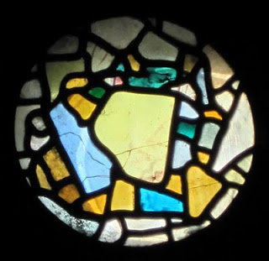
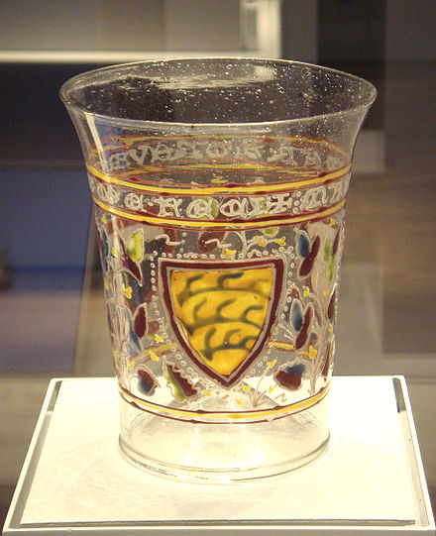
European history
Oldest Stain glass 670AD England
Impact on churches was significant
Early Murano (Italy) Glass 1330
Ultra pure silica pebbles
http://northeasthistorytour.blogspot.com/2011/03/oldest-stained-glass-window-in-world.html
http://en.wikipedia.org/wiki/Venetian_glass

Slide 19
History Continued
1500’s and 1600’s development of telescopes and microscopes
Revolutionized science and medicine
Galileo and the solar system
Leeuwenhook and bacteria
Offshoot of the printing press?
1608 Jamestown first “industry”
the first export was glass to England
1959 UK Invention of Float Glass
Use molten Tin
1970’s development of Fiber optic glass
Create chlorides and distill
Repeaters every 18.5 miles, handle 24000 calls/fiber

Slide 20
Changing the properties of Glass
Glass is brittle
But class is very strong in compression
How does one combine these observations to make glass stronger?
Rupert Drop
Corning ware
Gorilla Glass

Slide 21
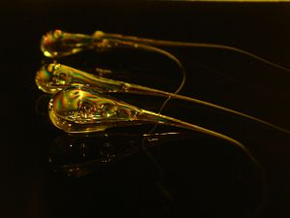
Rupert Drop
Origin as early as 1625
Prince Rupert gave them to King Charles II in 1660 who gave them to the Royal Society for study
http://ceramics.org/wp-content/video/rupert_drop.jpg
http://www.youtube.com/watch?v=xe-f4gokRBs

Slide 22
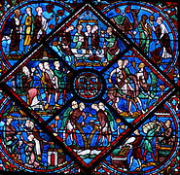
Changing the color of glass
http://www.paradoxplace.com/Photo%20Pages/France/Chartres/Joseph_Window/Images/900/Joseph-upper-middle-Sept07-DE7142sAR900.jpg
Blue - Typically Cobalt <0.1%
Red – metallic Gold 0.001%
- metallic Copper
Yellow – Silver Nitrate,
- Even Uranium
Purple – Manganese
- Nickel
White – Tin oxide with antimony or arsenic oxides
13th-century window from Chartres showing extensive use of the ubiquitous cobalt blue
www.Wikipedia.com

Slide 23
Some typical additives to glass
Na₂CO₃ (Natron or Soda Ash) network modifier
CaO (lime) network Former
MnO₂ masks the green color from iron
Antimony (turn Fe⁺⁺ to Fe⁺⁺⁺) make colorless
PbO (leaded glass) High dispersion crystal
B₂O₃ (pyrex) low thermal expansion
Al₂O₃ (aluminosilicate glass) fiberglass
ThO₂ Thorium Oxide low dispersion lenses
(radioactive) no longer used
La₂O₃ rare earth glass for cameras and telescopes
(not radioactive)

Slide 24
Closing thought
As Mark Miodownik observed in his book “Stuff Matters”
“Perhaps it is because we look through it rather than at it that glass has not become a part of the treasured fabric of out lives. The very thing that we value it for has disqualified it from our affections It is inert and invisible not just optically but culturally”
However I would add that with the growth of new applications as you will observe with functional ceramics, these materials may indeed become treasured materials for what they can do rather than how they look.

Slide 25
Additional Modern applications
Float Glass https://www.youtube.com/watch?v=ig4G5WbOMLc
Gorilla Glass https://www.youtube.com/watch?v=wT8xI4PEU8c
Fiber Optics https://www.youtube.com/watch?v=0MwMkBET_5I

