Slide 1


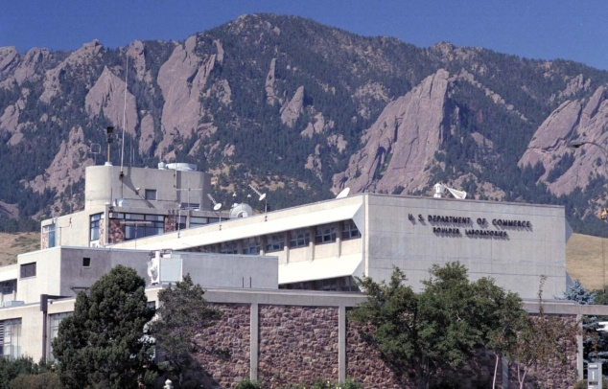

Determination of Axial Variations in Carrier Concentration in n-type GaN Nanowires by Raman Spectroscopy
Kris Bertness
NIST, Boulder, CO
Lawrence Robins, Shannon Duff, Paul Blanchard, Matt Brubaker
Notes:
Audio clip set to Start: Automatically
Audio icon (speaker shape) is set to Hide During Show in the Playback Menu
Transitions is set to Advance Slide After : 00:28.00
Audio clip is slightly longer than transition time, but program waits for audio to complete before advancing.

Slide 2
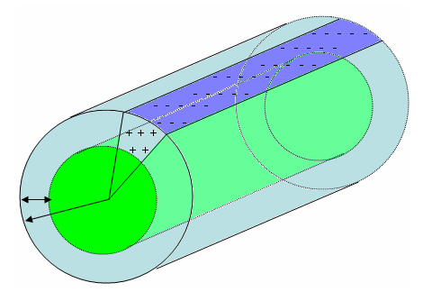
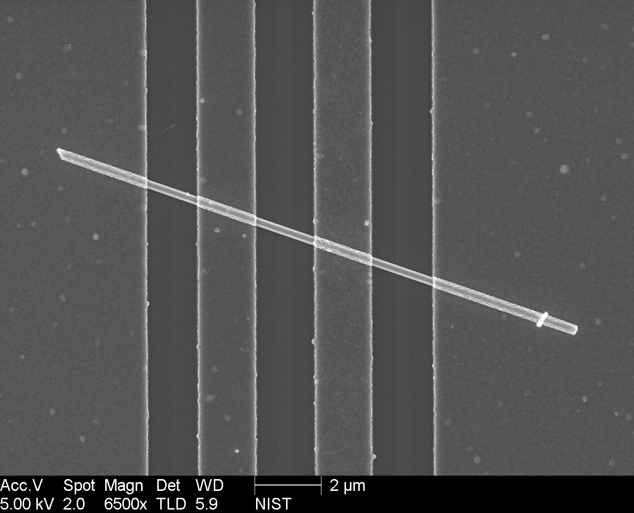
Why Raman Spectroscopy?
Direct electrical measurements are complicated by separate contributions of mobility, carrier concentration and surface band bending
Spatial uniformity measurements limited to metal pad dimensions
Surface charge
Depletion charge
Depletion
width
d
Measured
radius
r_{m}
R = R_{c,tot} + L / (A_{xs} ∙ q ∙ µ ∙ N_{d})
Raman measurements do not require electrical contacts and have good spatial resolution
contacts
Current shunted into pads
Notes:
Can break up audio into two chunks. Both should be Start After Previous and Start Automatically
Allows you to take a break to breathe or to correct one track without having to re-record the other
You can rearrange the order in the Animations pane

Slide 3
N-Doping – Top-view Raman Spectroscopy
65º
HeNe 632.8 nm,
21 mW
s
p
Spectrometer and CCD array detector
Backscatter geometry;
Beams independently polarized p or s
L. Robins, et al., J. Appl. Phys. 120 (2016) 124313.
Longitudinal phonon-plasmon coupled modes (LPP+) and surface-plasmon-coupled modes (SO) shift as free carrier concentration increases
Notes:
Powerpoint has a Trim Audio feature in the Playback menu so you can trim out clicks or empty space at the start or end of a clip.

Slide 4


Raman Intensity Model
LPP peak frequencies are the solutions of ε(ω)=0, for
dielectric function ε(ω) with phonon and plasmon contributions:
ω_{LO} , ω_{TO} : LO , TO phonon frequencies; Γ , γ : respective linewidths
ε∞ : high-frequency dielectric constant
Solve for ε(ω)=0 (neglecting the damping terms Γ , γ ):
Plasma frequency (ω_{P})
where n = free carrier concentration,
m* = free carrier effective mass
(from M. Yoon et al., Jpn. J. Appl. Phys. 44, 828 (2005) )
( See also review by H. Harima, J. Phys.: Condens. Matter 14, R967 (2002). )
Notes:
Tip: Repeatedly using the Record audio function appears to overwrite the previous recording but sometimes adds blank audio space at the end of the recording. The slide will not advance until the recording has fully played even if the Advance Slide time has passed. If you make a mistake while talking, it’s best to just cancel the recording and start with a fresh window. Alternatively, you can use the Trim Audio function in the PlayBack ribbon to remove extra empty space in the audio recording.

Slide 5
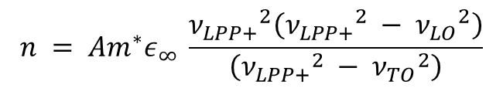
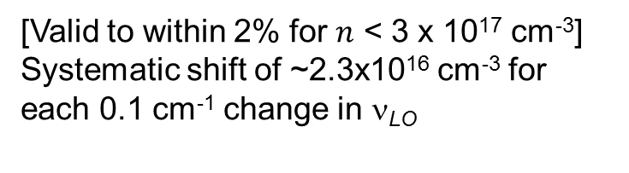
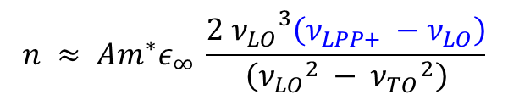
LPP+ Shift vs. Carrier Concentration
$$n = Am^{∗}ε_{∞} \frac{{ν_{LPP+}}^{2}\left({ν_{LPP+}}^{2} −{{ ν}_{LO}}^{2}\right)}{\left({ν_{LPP+}}^{2} −{{ ν}_{TO}}^{2}\right)}$$
For small n,
Shift (ν_{LPP+} - ν_{LO} ) is linear in n :
$$n ≈ Am^{∗}ε_{∞} \frac{{{2 ν}_{LO}}^{3}\left(ν_{LPP+} −{ ν}_{LO}\right)}{\left({ν_{LO}}^{2} −{{ ν}_{TO}}^{2}\right)}$$
[Valid to within 2% for $n$ < 3 x 10¹⁷ cm⁻³]
Systematic shift of ~2.3x10¹⁶ cm⁻³ for each 0.1 cm⁻¹ change in ν_{LO}
Results for MBE grown GaN nanowires
n : carrier concentration
A : constant including speed of light, mass and charge of the electron, dielectric constant of free space, and numerical factors
: frequencies for coupled plasmon-phonon (LPP+), longitudinal optical phonon (LO) and transverse optical phonon (TO), in cm⁻¹

Slide 6
Uncertainty in ν_{LO} limits accuracy
LPP+ peak location is measured relative to ν_{LO} to determine n
GaN has two closely spaced LO phonon peaks- A₁(LO) at 734 cm⁻¹ and E₁(LO) at 741 cm⁻¹
In films, selection rules operate such that one or the other can usually be eliminated (e. g. E₁(LO) does not contribute in back-scatter geometry)
Top view Raman measurements show a mixture of the two phonon modes producing a quasi-LO peak with frequency 739.10 ± 0.12 cm⁻¹ for undoped material
Agrees with geometrical average of completely randomized paths and polarizations
What happens in edge-on geometry?
Notes:
The click heard at the end of some of these audio tracks is from clicking the mouse on the red dot to stop recording. It has been edited out in the second track, Slide6b, using the Trim Audio function available when the Playback menu has been selected.

Slide 7
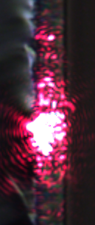
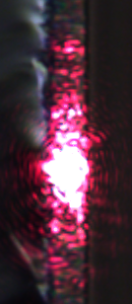
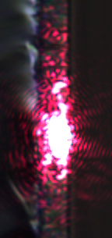
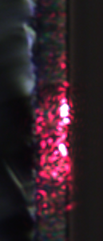
Spatial Resolution
NWs (~ 11 µm)
Spot size on sample surface (estimate):
1.0 μm parallel to NW axes, 2.4 μm in plane of incidence
Multiple scattering appears to increase probed volume to sample a distance along nanowire length of about 3 μm

Slide 8
Edge-on Data
(p, p)
s
p
-c axis
Sample stage on piezo motion stage to move sample out of plane of incidence in 1 µm steps
Apparent carrier concentration increases toward tip, and then a slight decrease
Increase similar for a variety of runs ( ~4 x10¹⁶ cm⁻³), including undoped nanowires – hard to explain with a growth mechanism
Could this be a shift in the quasi-LO mode due to different mixing of modes?

Slide 9
Polarization affects peak intensities in edge-on measurements
A₁(TO)
E₂
E₁(TO)
LPP+
Intensity ratios of different Raman peaks varies with polarization geometry
For top-view measurements, intensity ratios did not vary with polarization
Implies that scattering does not completely randomize directions and polarization in edge-on measurements

Slide 10
(A₁, E₁) Mixing Varies Due to Geometry
D262
D325
bars: 5 µm
Contribution of A₁ vs E₁ to quasi-LO phonon changes due to tapering and/or change in density of material
Suggests that accuracy could be improved with length-dependent quasi-LO phonon values from undoped calibration sample of similar morphology
Notes:
This audio was recorded using a headset.

Slide 11
Corrected Carrier Concentrations
p, p
TIP
Corrected using quasi-ν_{LO} that varies with fractional length based on undoped specimen

Slide 12

Summary
Raman spectroscopy demonstrates very little gradient in carrier concentration along length of Si-doped GaN nanowires grown by MBE
Uncertainty limited by quasi-LO mode frequency mixing in multiple scattering events
Mixing less homogeneous in edge-on geometry
Accuracy improves when quasi-LO frequency is corrected using data from a low-carrier-concentration sample with similar morphology
12
Notes:
The talk runs almost exactly 12 minutes, which is what we expect of all contributed talks.
This audio was recorded on a cell phone and emailed to my computer.
The next slide is a supplemental slide that could be used during the Q&A, so the current slide requires a mouse click to advance. I would have to ask the technical host to advance the slide for me if I want to use this slide to answer a question.

Slide 13
Raman Experimental Set-up
Laser wavelength: 632.8 nm (wavenumber 15803 cm⁻¹)
Incident laser power: 21 mW
Spot size on sample surface (estimate): 2.4 μm × 1.0 μm
Incident intensity on sample surface: 1.0×10⁹ W/m² to 1.6×10⁹ W/m²
Angle of incidence on sample surface: oblique, 65° from normal
Incident polarization control: can be set to p-polarized (in plane of incidence on sample) or s-polarized (⊥ plane of incidence)
Scattered-light polarization control: p-polarized or s-polarized
Spectrometer: 0.5 m focal length, single grating, 1800 groove/mm
Detector: l-N₂ cooled CCD array, 1340(horiz)×100(vert) pixels (20 μm size)
Wavenumber resolution: approx. 1 cm⁻¹ in wavenumber range of interest

