Slide 1
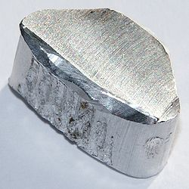
Aluminum
Aluminum
The most abundant metal in the earths crust (only Si and O are more abundant)
Properties
Relatively soft,
Durable
Lightweight
Ductile
Appearance ranging from silvery to dull gray
It is nonmagnetic and does not easily ignite
A good reflector (approximately 92%) of visible light
The yield strength of pure aluminum is only 7–11MPa (steel is 250-500MPa)
Corrosion resistant except in salt water
Low emissivity
Difficult to weld (TIG)
Why is it useful?
Wikipedia.com
Notes:
What did you think of the books?
What is your opinion of the respective writing styles? Organizations?
What did you learn from reading two accounts of the same period? Did you notice differences in emphasis?

Slide 2
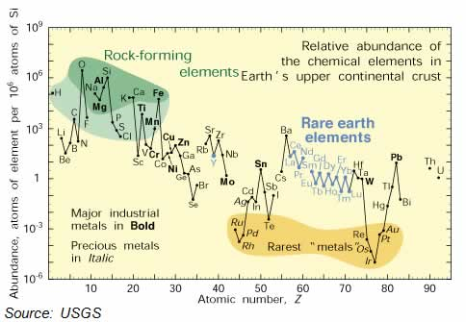

Slide 3
Challenges with Aluminum
Certain metal oxides are very stable and Al2O3 is one of them.
Charcoal and CO cannot reduce Al2O3
Alchemy based on turning metals into gold
By 1700’s beginning to realize this is futile
To understand how we get Aluminum need to understand the history of oxides
Studies of Phlogiston
Firey substance possessed by Materials
Burning something gave off Phlogiston left Calx
Priestly isolated oxygen from mercury oxide using sunlight
Gas supported burning of candle but what is it?

Slide 4
Early Chemistry
1771 Antoine Lavoisier in France
Interested in Priestley’s work
Used careful balances weight products and reactants
Metal gains weight when heated in Air
Others assigned a negative weight to Phlogiston ?
Lavoisier repeated mercury oxide exp. both ways
Proved gas was oxygen and necessary for combustion
Laid theory of Pholgiston to rest and started modern chemistry
Proved S was an element not compound
First to organize elements by weight
First to show elements may change form but weight was fixed
1794 at 50 executed for selling dilute tobacco (French revolution)
Pardoned a year later

Slide 5
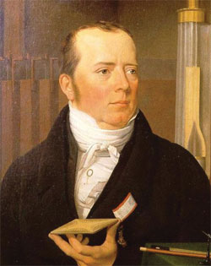
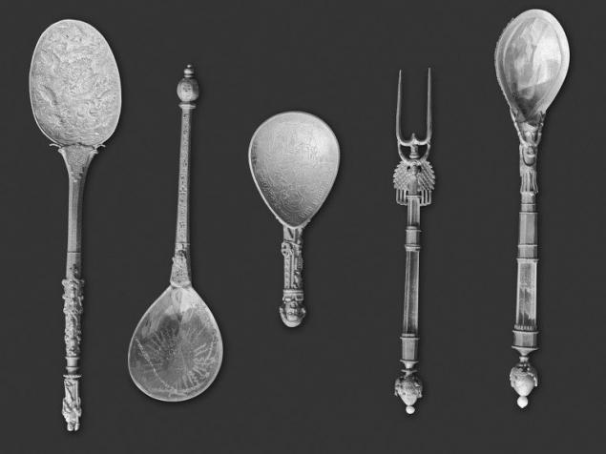
Aluminum Challenge Continued
How does one discover a metal that cannot be reduced by CO?
Must forcibly inject electrons
Volta Pile
Sir Humphrey Davy 1807
Use Cu and Zn that had been reduced using CO
Generate electricity (battery) and reduce potash
K₂SO₄ and NaOH turned into Na and K metals
Hans Orsted first to reduce Al 1825
Used Potassium metal to reduce Aluminum chloride
Sodium also worked and for 60 years this was the only way to make Al
Very expensive (much more valuable than gold)
Napoleon III used Al dinnerware for best guests (others got gold)
Hans C. Orsted
http://www.aps.org/publications/apsnews/200807/physicshistory.cfm
http://bashny.net/t/en/275779

Slide 6
Aluminum Challenge continued
1886 Charles Hall(US) and Paul Heroult (France)
Independently invent cheap method of producing Al
What was the challenge?
Must first isolate Al₂O₃ from Bauxite use Bayer Process
Convert to Al(OH)₃ and back to Al₂O₃
Needed to use electricity to reduce Al₂O₃
Al₂O₃ is not conductive so can’t just apply electrodes
Melts 2072°C yikes! Made process very expensive
Cool trick Hall and Heroult figured out in 1885
Use Cryolite (Na₃AlF₆)
melts at ~950°C very accessible, much cheaper

Slide 7
Aluminum history continued
1856 cost of Al is $90/lb
1890 price drops to $0.30/lb
Worldwide production
1873 2.5 tons
1900 7300 tons
Today >40,000,000 tons
Consumes lots of electricity
Early plants concentrated near hydroelectric dams
Today uses ~15kWh of electricity per kilogram of Al
Consumes ~5% of electricity produced in US today
Greenhouse gas implications
Requires 95% less energy to recycle

Slide 8
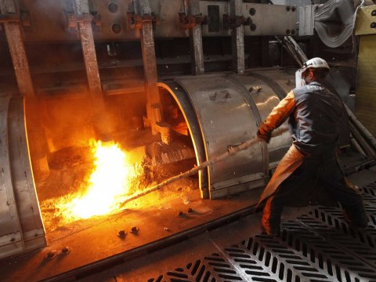
Al production
2011
1. United Co. Rusal 4,127 (Russia)
2. Rio Tinto Group 3,829 (Canada)
3. Alcoa Inc. 3,669 (US)
4. Chalco Aluminum Corp. of China 3,127 in
*thousands of tons
http://www.bloomberg.com/news/2012-02-27/top-10-aluminum-
companies-in-2011-by-production-table-.html
http://www.businessinsider.com/alcoa-q2-earnings-2015-7

Slide 9
Property challenge
Yield Strength
Pure aluminum is only 7–11MPa
steel is 250-500MPa
How do you make it strong?
Options
Solid Solution Strengthening like Bronze
Doesn’t work very well
Work Hardening like Bronze
Doesn’t work very well (you try it)
Precipitation Hardening
How does that work?

Slide 10
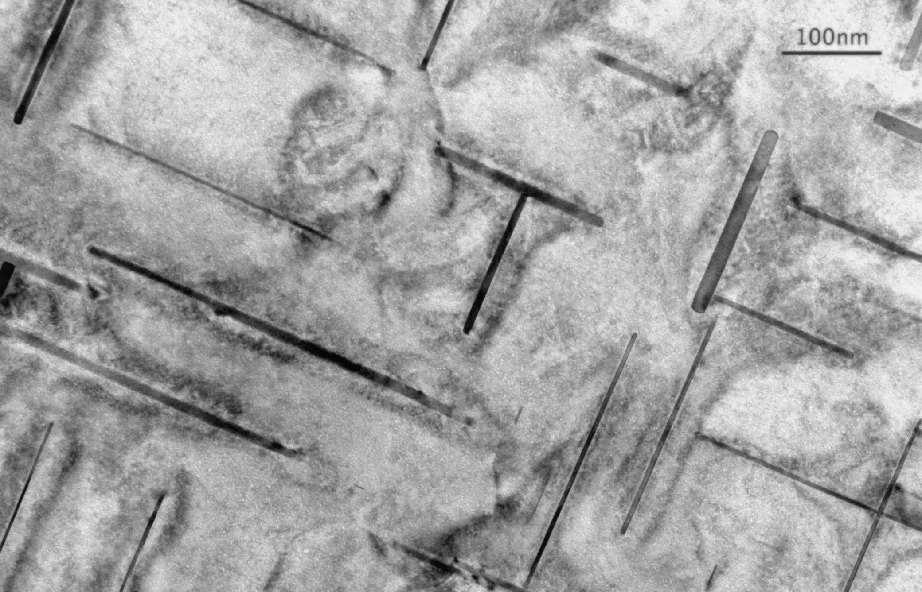
Precipitation Hardening
Add so much Copper (4%) or silicon to aluminum that when quenched its supersaturated (see phase diagram)
Heat up to low temperature
copper or silicon precipitates (like rock candy)
Precipitates block dislocations
Makes Aluminum very hard
Yield strength increases >100X
Also called Age hardening
https://en.wikipedia.org/wiki/Microstructure

Slide 11
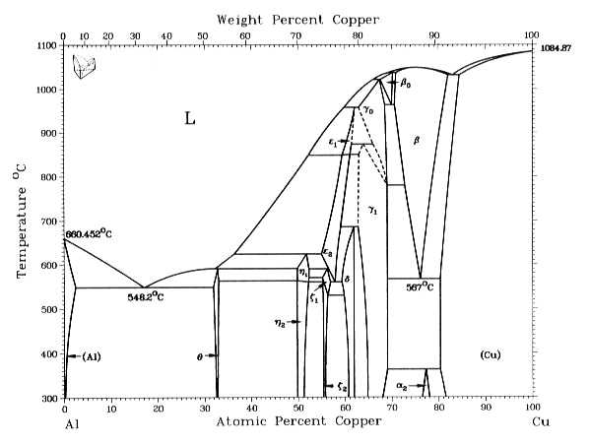
Strengthening mechanisms
oregonstate.edu/instruct/me582/Exams/W09/ME582MT2.html

Slide 12
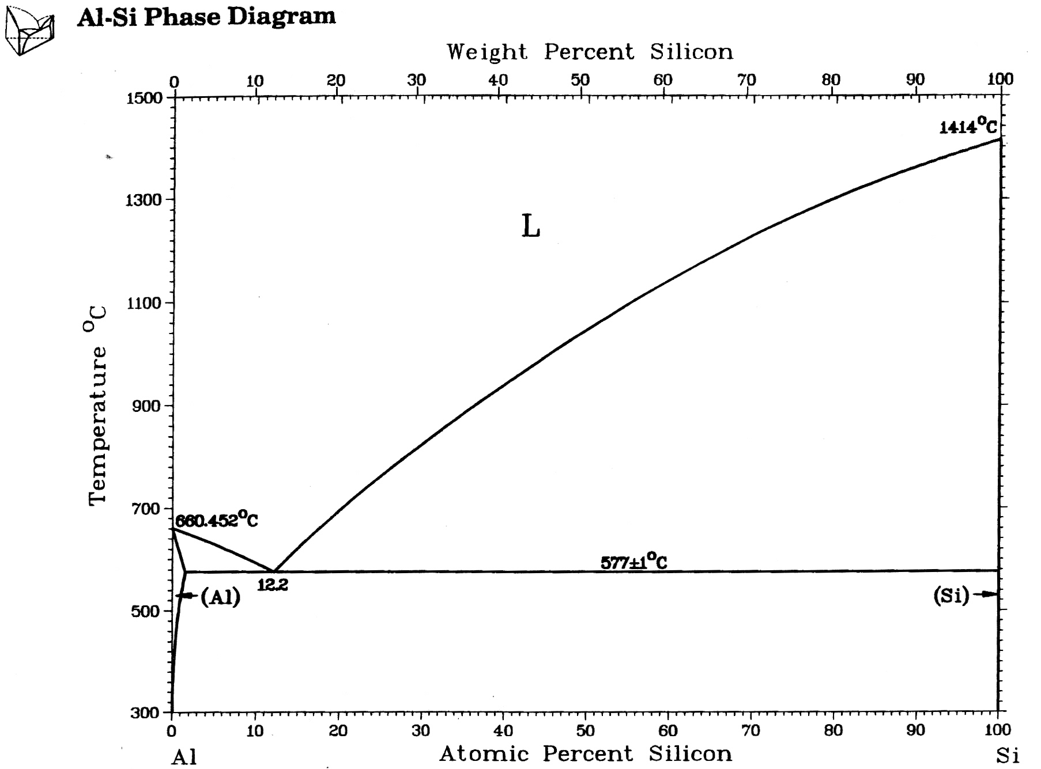
Al-Si

Slide 13
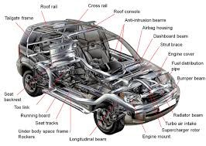
Aluminum Applications
Many applications
Transportation (automobiles, aircraft, trucks etc.)
Beverages
Construction (windows, doors etc)
Cooking Utensils
Street lights
Laptop casings
Electrical Transmission lines
Cell Phone casings
Aluminum foils
Sporting goods (e.g. bats etc.)
http://www.aluminumextrusiongroup.com/automotive-applications/

Slide 14
Aluminum Applications
Many applications so focus on one: Aircraft
Strength to weight ratio critical in Aircraft
Strength may be slightly less but weight is 1/3
Specific strength is 50% higher for Al
Susceptible to Cyclic fatigue
Pressure cycling
Fails below yield strength
Cracks are key
Small crack 1/1000 mm no problem
But if after hundred of cycles it grows to 1mm can be catastrophic

Slide 15
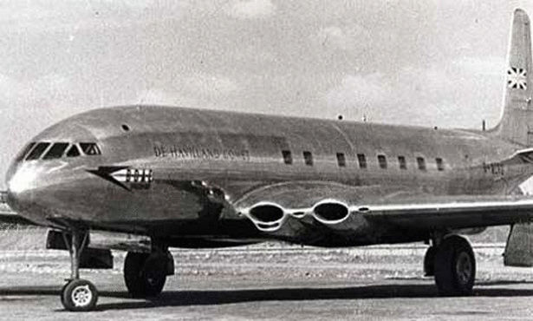
Aircraft
British DeHavilland Comet 1952
4 crashes in 2 years
Result of rivets and square windows (stress razors)
Reengineered by 1958 but too late
Boeing had launched 707 by 1958
Took over the market
In 2009 Civilian Aircraft accounted to 7.1% of all exports
Largest single export
http://www.extremetech.com/extreme/129764-tech-wrecks-lessons-from-some-of-the-biggest-hardware-screw-ups/3

Slide 16
Corrosion
Al is extremely reactive if powdered
Solid rocket fuel for Shuttle (Al + H₂0 => Al(OH)₃)
Why does Aluminum stay shiny and not rust?
Aluminum oxide coating very thin but conformal
Protects surface from further oxidation
When you mix metals the one that wants the oxygen most, wins and corrodes.
This means that almost always the Aluminum corrodes so be careful (seaplane)
Why does Aluminum fail at the beach?
The chlorine in salt water helps corrosion
Forms pits at grain boundaries etc.

Slide 17
Aluminum Refinement
Hall–Héroult process
http://www.youtube.com/watch?v=WFL9kpHCKe4
http://www.youtube.com/watch?v=EK4dEEoKNiE
Notes:
What did you think of the books?
What is your opinion of the respective writing styles? Organizations?
What did you learn from reading two accounts of the same period? Did you notice differences in emphasis?

Slide 18
Impact Paradigm
Material
What is the material of importance?
What are the general properties of this material?
What is the source of the material?
What is the general abundance of the material?
What are the unique (enabling) properties of the material?
What discovery/development led to the material impacting society?
Notes:
These questions are to be asked in class, relying upon the students reading of the assigned material. Although the answers are largely obvious, the exercise is intended to prepare students of an approach to regularly assessing the question of how a materials set impacts society.

Slide 19
Impact Paradigm
Historical
What is the first known use of the material?
What people groups were involved at the time of first use?
At what time did the material become enabling?
What events limited the impact of the material prior to or following its development/discovery?

Slide 20
Impact Paradigm
Technological
What technology did the material enable?
What role did the material play in the technology?
What property of the material enables the technology?
What are the limits of the technology?

Slide 21
impact Paradigm
Societal
In which realms of society did the materials development have an impact?
What were the financial implications of the development?
What were the health implications of the development?
What were the governmental implications of the development (war)?
What were the social implication of the development?
What are the future societal needs with respect to the material/technology?

