Slide 1
Copper and Bronze
https://www.youtube.com/watch?v=-JunmomMSK0

Slide 2
Copper and bronze
What are properties of copper and bronze?
Metallic
Malleable
Opaque
Electrically conductive
Thermally conductive
Orange
Shiny
Hard

Slide 3
Copper vs Bronze
Copper
Is a pure element
Named after where it came from Cyprus (Cu)
Melting point around 1084*C
Bronze
Is an alloy of copper and an impurity (Arsenic or Tin)
Named after the Italian word Bronzo for bell Metal
Melting point varies but around 950°C

Slide 4
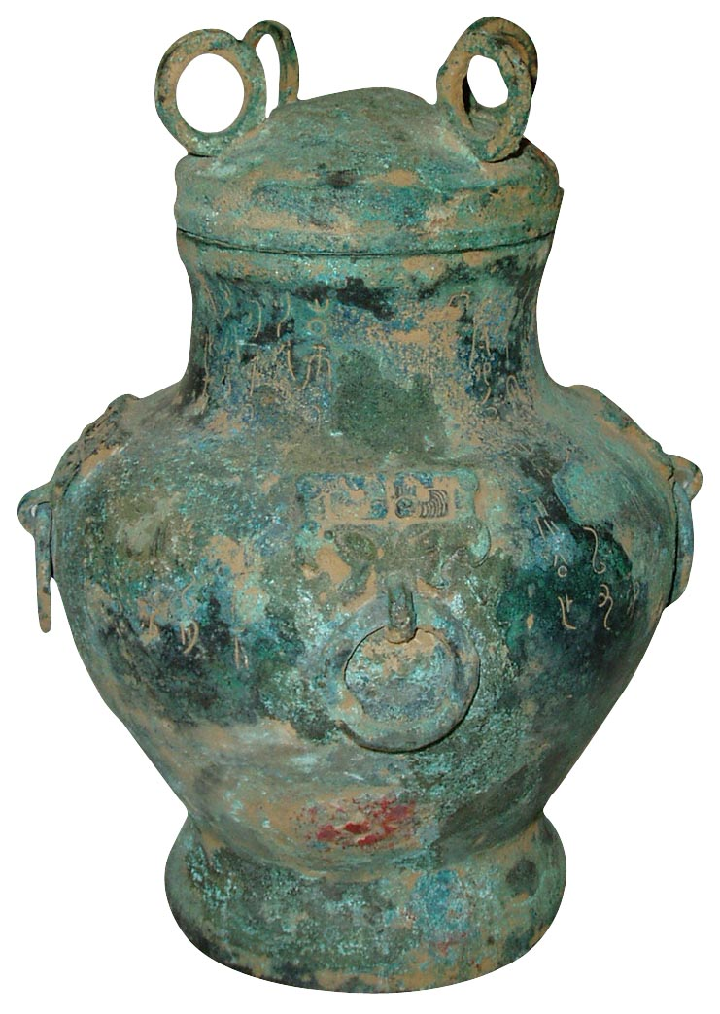
The Bronze Age
The early story of copper likely involved the role of serendipity—finding raw copper samples or inadvertently placing copper containing ores near or in a fire.
In the course of generating higher temperatures, early metal workers empirically developed the process of smelting.
Smelting provides increased temperatures as well as the pathway to a specific chemical reaction instrumental in removing (reducing) metals from their ores.
This course contains copyright materials that are used solely for instructional purposes within this course. Copying, printing or distribution for other purposes is prohibited
http://www.supplierlist.com/prod_img/qiguoying/21961_Elegant_Ancient_Bronze_Cooking_Vessel_From_China.jpg
Notes:
What did you think of the books?
What is your opinion of the respective writing styles? Organizations?
What did you learn from reading two accounts of the same period? Did you notice differences in emphasis?

Slide 5
Smelting
Until now the ancient materials we have discussed did not change oxidation state
To make a metal other than Gold typically requires reducing it chemically
For copper the reaction is simple
Take malachite (CuCO₃) and carbon (charcoal) heat and copper will form
140 pounds of wood makes 20 pounds of charcoal along with which in turn makes 1 pound of Copper
Resource intensive
Must find lots of copper ore

Slide 6
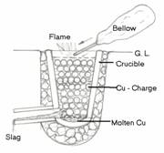
Smelting
Common smelting practices call for the mixing of ore with charcoal.
The incomplete combustion of the charcoal produces carbon monoxide.
Carbon monoxide reacts with the ore to produce carbon dioxide and elemental metal.
Be prepared to write the chemical equations describing the smelting of a copper oxide ore.
Notes:
What did you think of the books?
What is your opinion of the respective writing styles? Organizations?
What did you learn from reading two accounts of the same period? Did you notice differences in emphasis?

Slide 7
Why call it the Bronze age?
Copper
Hardness of ~80 Mpa
Yield Strength 70MPa
Bronze
Hardness of 170MPa
Yield Strength ~220MPa
Why is Bronze harder and stronger?

Slide 8
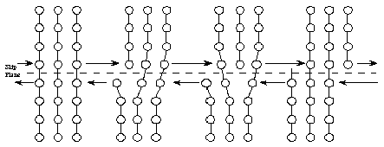
Strengthening Mechanisms
Copper was relatively easy to refine
However it is also very soft
There are multiple methods of strengthening
The key is slowing down dislocation motion
What’s a dislocation?
Dislocation
http://depts.washington.edu/matseed/mse_resources/Webpage/Metals/metalproperty.htm

Slide 9
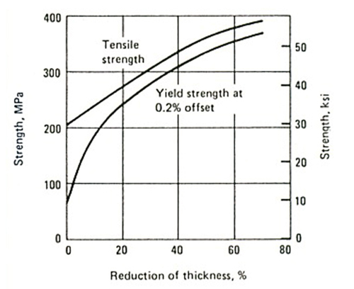
How do you slow down a dislocation?
Work Hardening
Add lots of additional dislocations
They get tangled
Makes it difficult for them to move
Cold rolling copper increases the tensile strength
http://www.eng.nus.edu.sg/EResnews/022011/rd7.html
http://www.australwright.com.au/c11000-etp-copper/

Slide 10
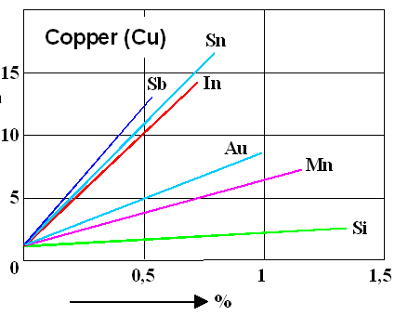
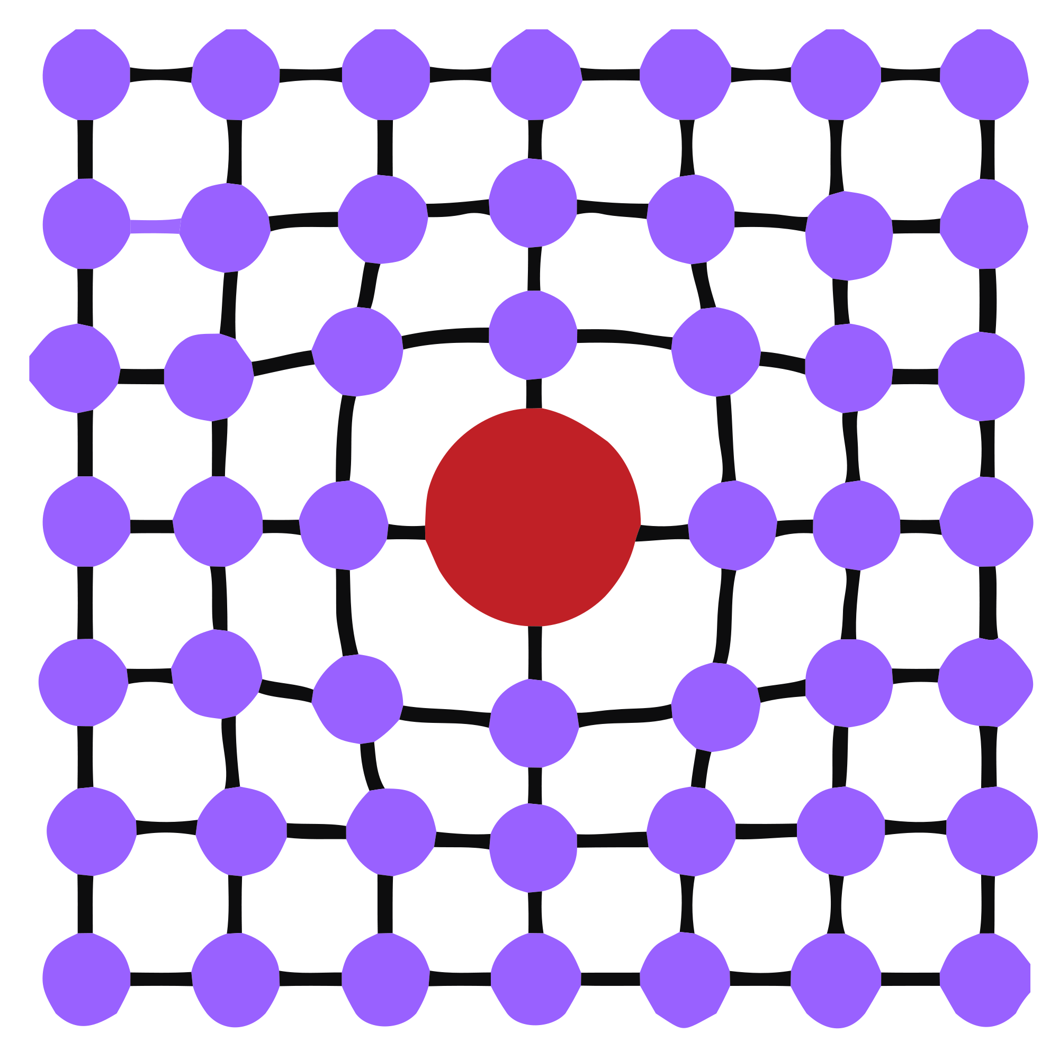
How else do you strengthen Copper
Impurities
Lots of hardening mechanisms
Solid solution hardening is one
Put other atoms into the matrix that block the dislocations
Early on used Arsenic
Later used Tin
Maximum Yield Strength (MPa)
Impurity
https://en.wikipedia.org/wiki/Strengthening_mechanisms_of_materials
http://www.tf.uni-kiel.de/matwis/amat/iss/kap_8/backbone/r8_3_1.html

Slide 11
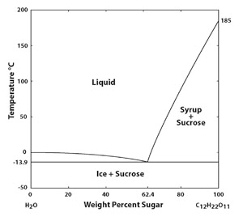
What happens when you add an Impurity? Need a Phase Diagrams
Water sugar phase diagram
Critical for making Ice Tea!

Slide 12
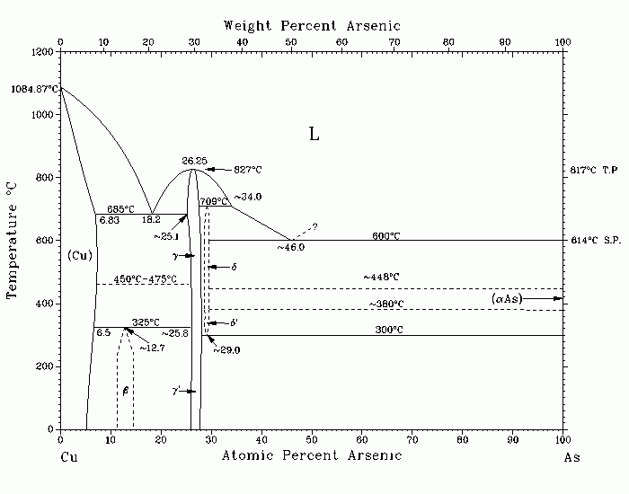
Cu-As Bronze Phase Diagrams
Binary (2-component) phase diagrams (e.g. Cu-As) typically consider composition (x) versus temperature (y) behavior
In this phase diagram, only solids and liquids appear.
Solid lines still represent the separation between distinct phases.
Melting point
Ancient Bronze
http://www.himikatus.ru/art/phase-diagr1/As-Cu.php
Notes:
What did you think of the books?
What is your opinion of the respective writing styles? Organizations?
What did you learn from reading two accounts of the same period? Did you notice differences in emphasis?

Slide 13
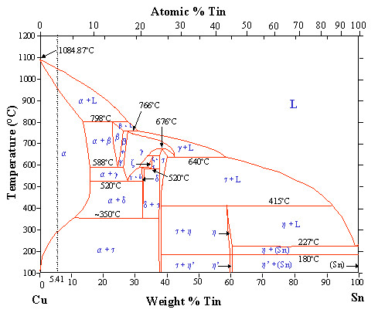
Cu-Sn Bronze Phase Diagrams
Copper-Tin Bronze
Can dissolve more Tin in Cu than As
Tin is less toxic
Tin is harder to find
solubility
http://pwatlas.mt.umist.ac.uk
Notes:
What did you think of the books?
What is your opinion of the respective writing styles? Organizations?
What did you learn from reading two accounts of the same period? Did you notice differences in emphasis?

Slide 14
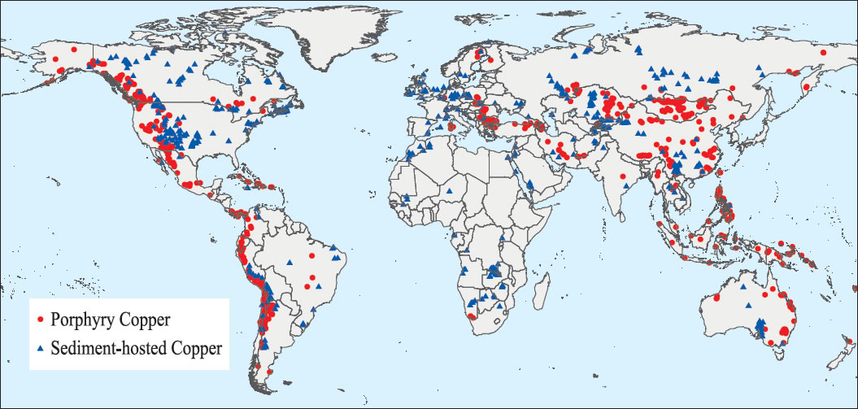
The Bronze Age
Where is Copper?
With the desire for improved properties, early coppersmiths likely began to draw correlations between copper sources, processing conditions, and resulting mechanical properties.
Different regions of the world are know to contain copper deposits of varying purity as well as being composed of various impurities.
Common impurities include arsenic and tin, separately found in different samples.
Notes:
What did you think of the books?
What is your opinion of the respective writing styles? Organizations?
What did you learn from reading two accounts of the same period? Did you notice differences in emphasis?

Slide 15
The Bronze Age
Arsenic is naturally found in many copper deposits.
The presence of arsenic will produce an altered color as well as increasing the hardness of copper.
Arsenic possesses a lower melting point that copper and preferentially oxidizes during smelting, producing the toxic chemical AsO₃.
Notes:
What did you think of the books?
What is your opinion of the respective writing styles? Organizations?
What did you learn from reading two accounts of the same period? Did you notice differences in emphasis?

Slide 16
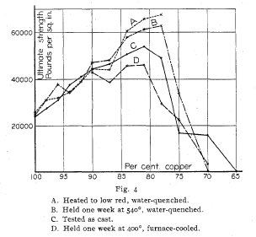
The tensile strength of copper tin alloys
Adding Tin increases the strength
Heat treating also changes strength.
Adding too much tin is bad Why?
Shepherd and Upton, J. Phys. Chem, 9, 441, (1905)

Slide 17
THE BRONZE AGE
As has been mentioned, our historical records are incomplete with regard to the development and implementation of early materials. Yet it is known that many materials saw parallel discoveries and developments in different parts of the world.
Near East 3300BC
Europe 3000BC
China 3000BC
India 3300 BC
England 2100BC
Korea 800BC
Japan 500BC
Peru 100AD www. Wikipedia.com
Notes:
What did you think of the books?
What is your opinion of the respective writing styles? Organizations?
What did you learn from reading two accounts of the same period? Did you notice differences in emphasis?

Slide 18
THE BRONZE AGE
What were the societal impacts associated with the development of the material bronze?
Health
Mining
Exploration and experimentation
Trade
Cornwall England was the primary early source of tin in central and northern Europe as far back as 2000BC
Notes:
What did you think of the books?
What is your opinion of the respective writing styles? Organizations?
What did you learn from reading two accounts of the same period? Did you notice differences in emphasis?

Slide 19
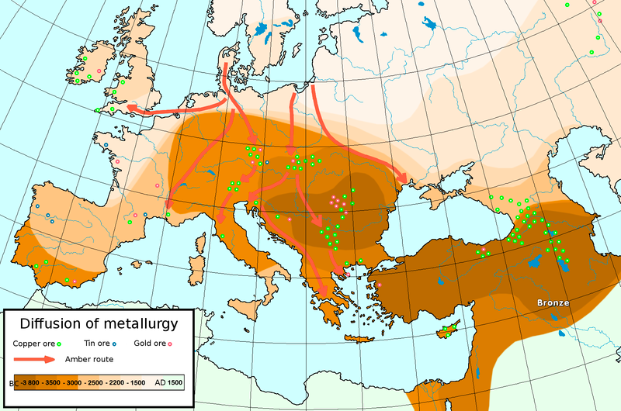
Bronze age Map
Wikipedia.com
https://s-media-cache-ak0.pinimg.com/736x/ba/71/7a/ba717a4069f76031457d1d0e5b198c0b.jpg

Slide 20
Bronze age Map
Where the Tin was mined
Where the Bronze was made
Trade was critical to the success of Bronze
https://en.wikipedia.org/wiki/Tin_sources_and_trade_in_ancient_times
https://s-media-cache-ak0.pinimg.com/736x/ba/71/7a/ba717a4069f76031457d1d0e5b198c0b.jpg
Wikipedia.com

Slide 21
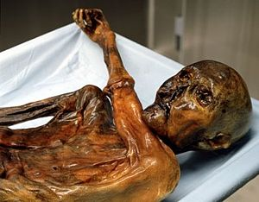
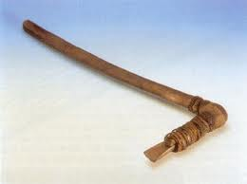
Otzi
3300BC
Oldest Chalcolithic Mummy
Found in 1991 in the Alps northern Italy
Under ice for 5000 years
High levels of both copper particles and arsenic were found in Ötzi's hair. This, along with Ötzi's copper axe which is 99.7% pure copper, has led scientists to speculate that Ötzi was involved in copper smelting
http://a57.foxnews.com/img.foxnews.com/static/managed/img/Scitech/660/371/OetzitheIceman02.jpg
Otzi’s Axe
wikipedia
https://s-media-cache-ak0.pinimg.com/236x/c6/41/3a/c6413aaa207762a1bb5f546ebb2eb249.jpg

Slide 22
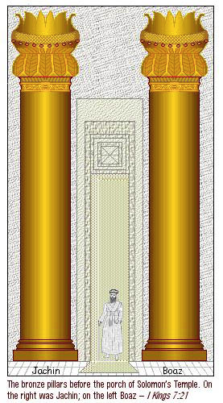
Early Bronze
1000BC King Solomans Temple
Built by Hyram of Tyree
39 feet tall
Pillaged
http://endtimelect.com/2013/02/02/the-two-pillars-boaz-and-jachin-the-entrance-to-the-temple-of-yhwh/

Slide 23
THE BRONZE AGE
http://www.supplierlist.com/prod_img/qiguoying/21961_Elegant_Ancient_Bronze_Cooking_Vessel_From_China.jpg
The development of bronze enabled casting technologies for the production of vessels, art, tools, and weapons.
http://www.wushumuseum.com/upload_files/image/200906/200906090943577070.jpg
http://history.cultural-china.com/chinaWH/images/exbig_images/fa72017a6d174c8307fde4ea4f178dbd.jpg
Notes:
What did you think of the books?
What is your opinion of the respective writing styles? Organizations?
What did you learn from reading two accounts of the same period? Did you notice differences in emphasis?

Slide 24
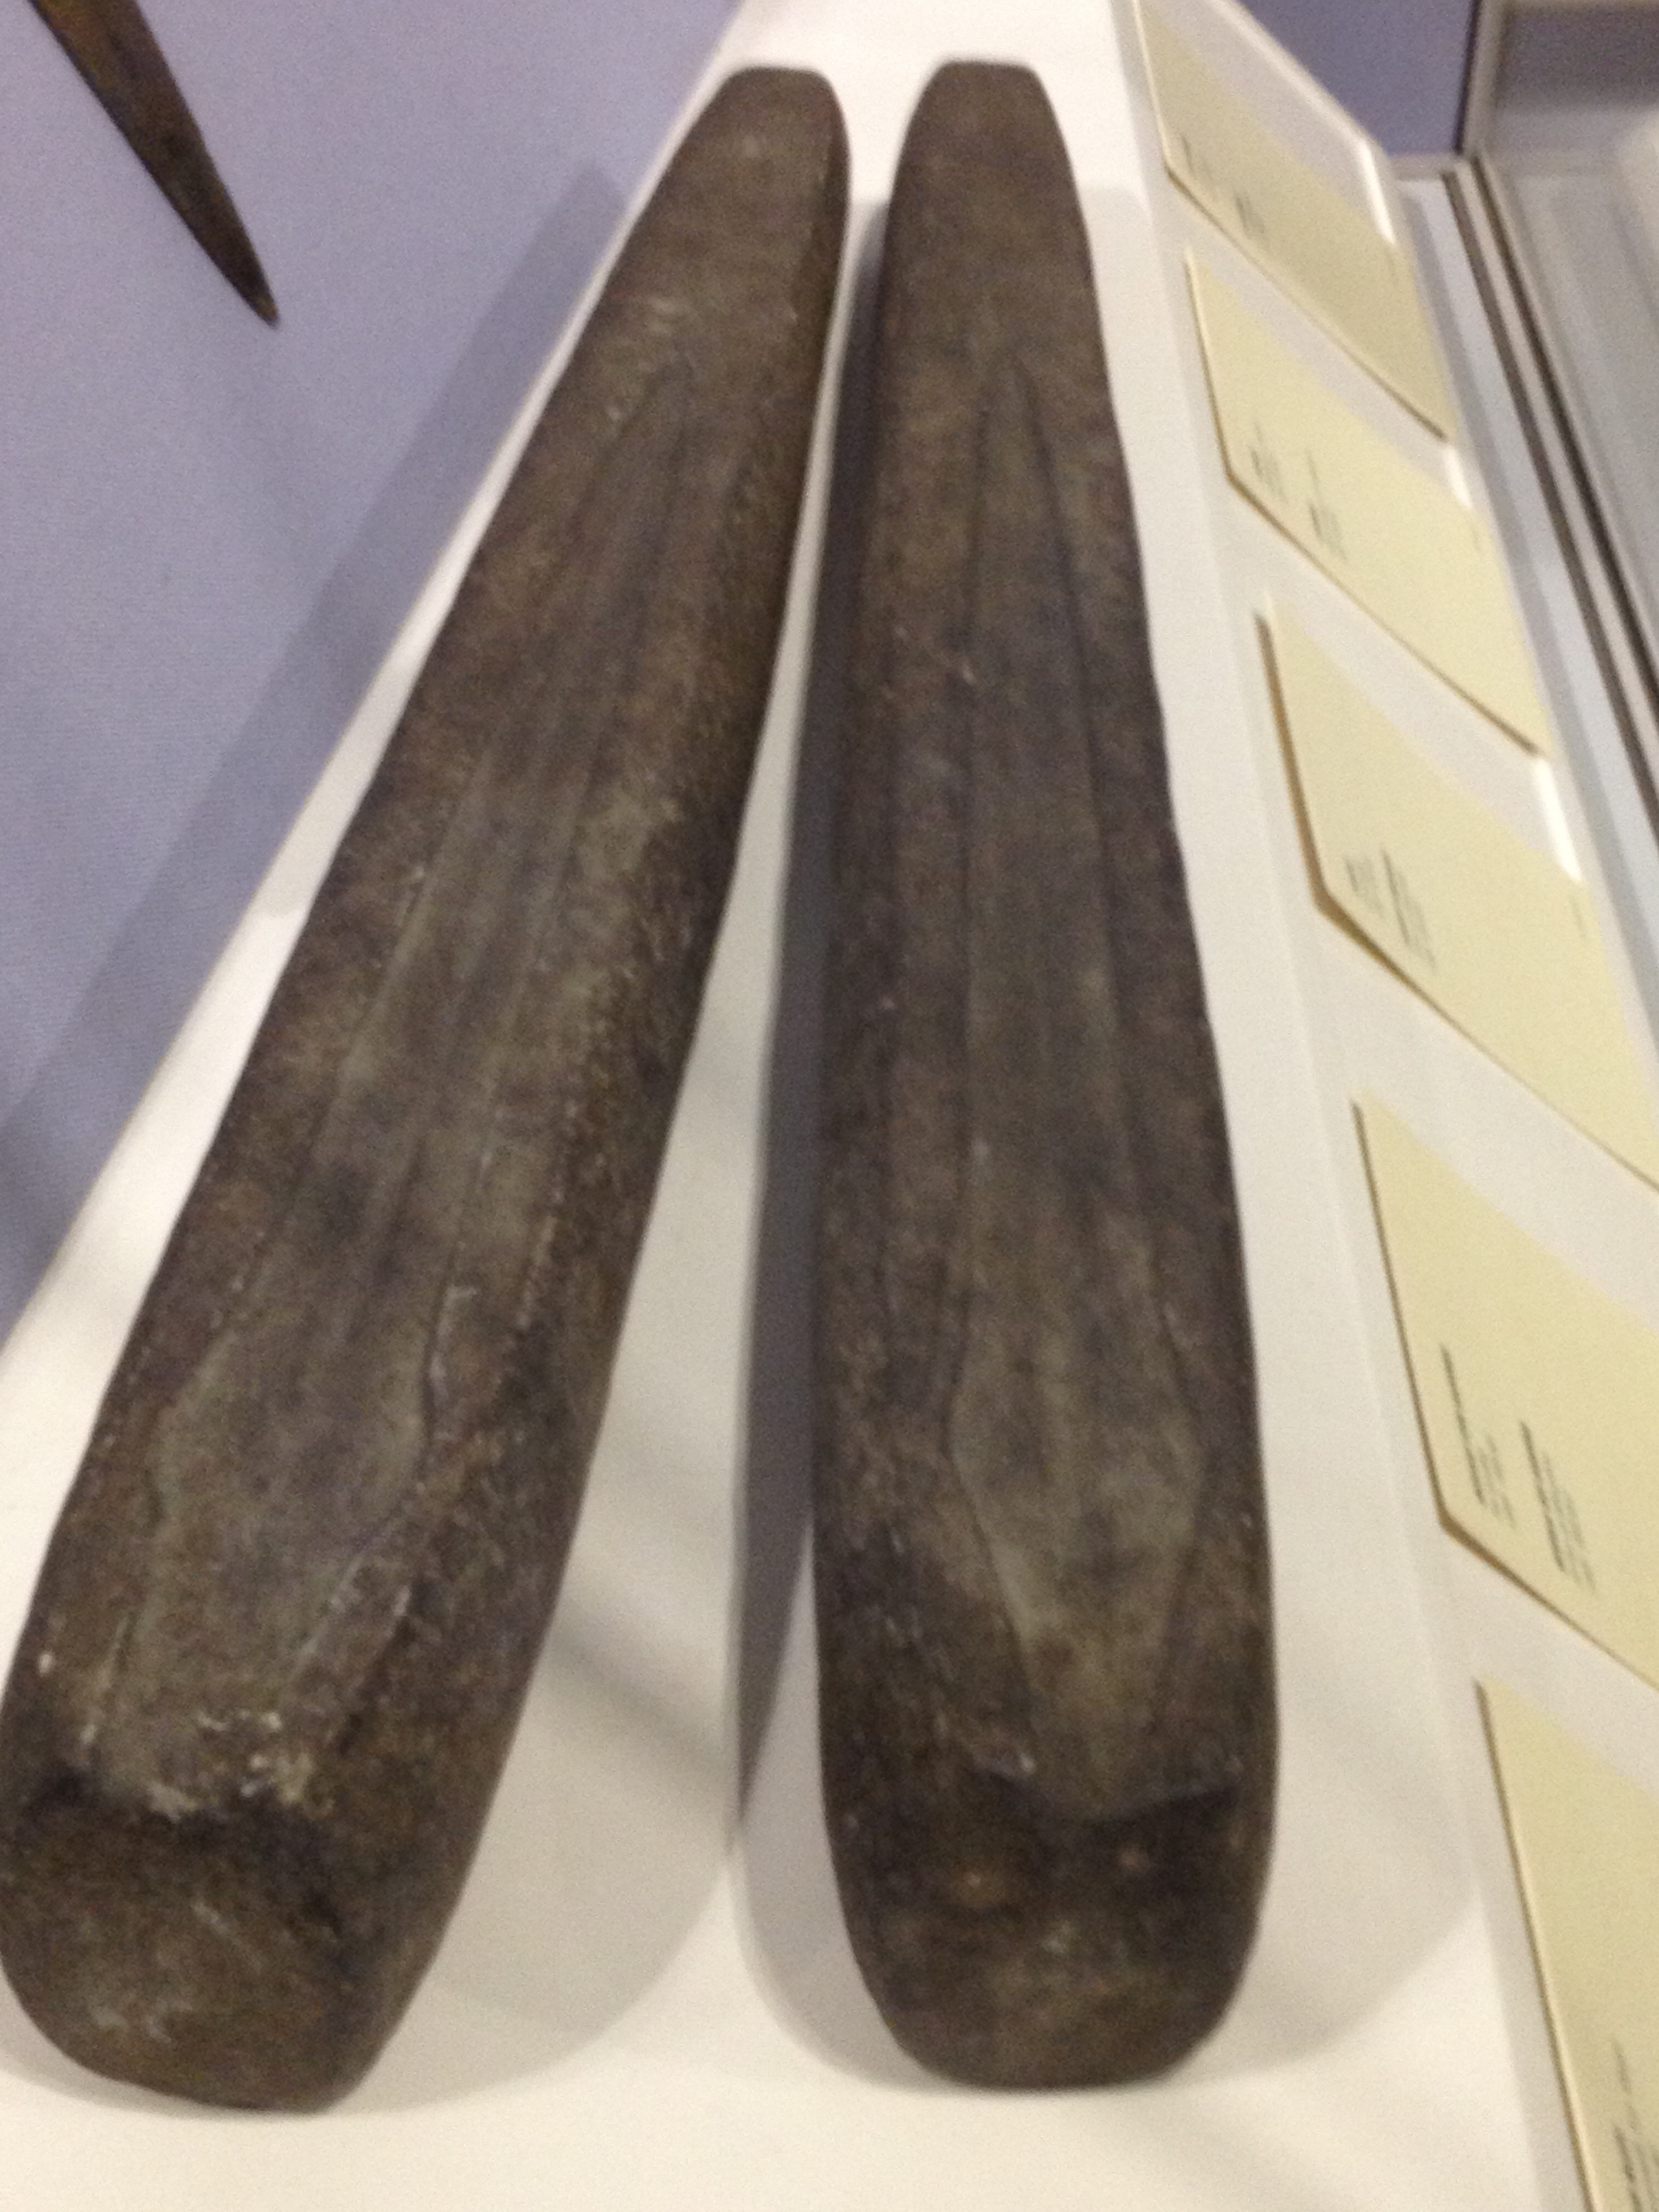
Molds for making Bronze Swords 900BC in Ireland

Slide 25
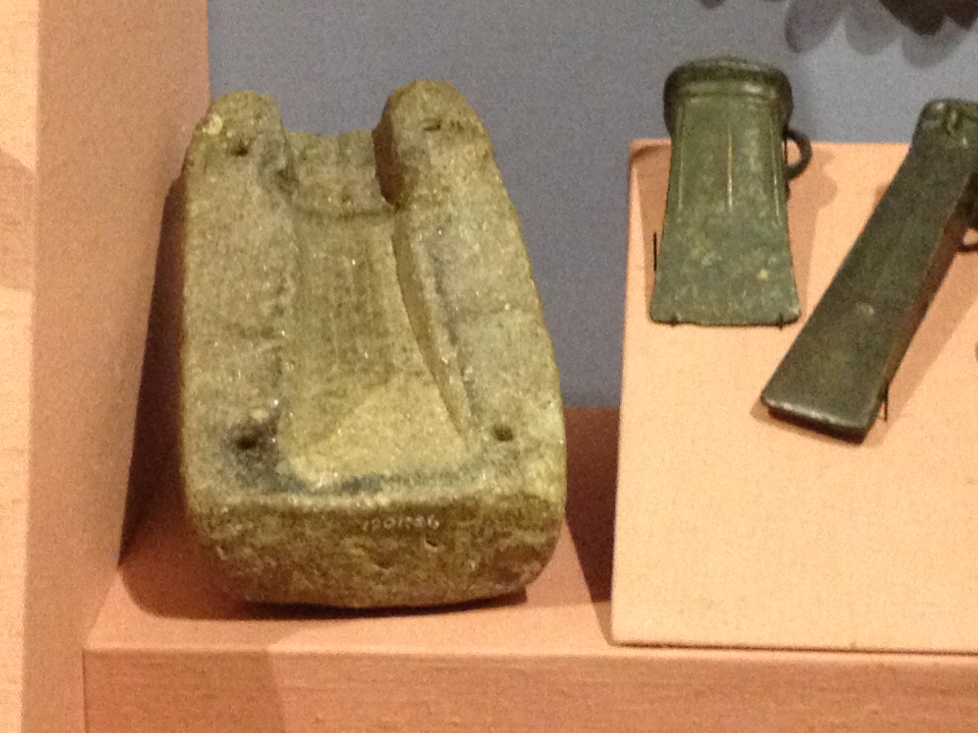
Mold for making Bronze Axe 900-500BC Ireland

Slide 26
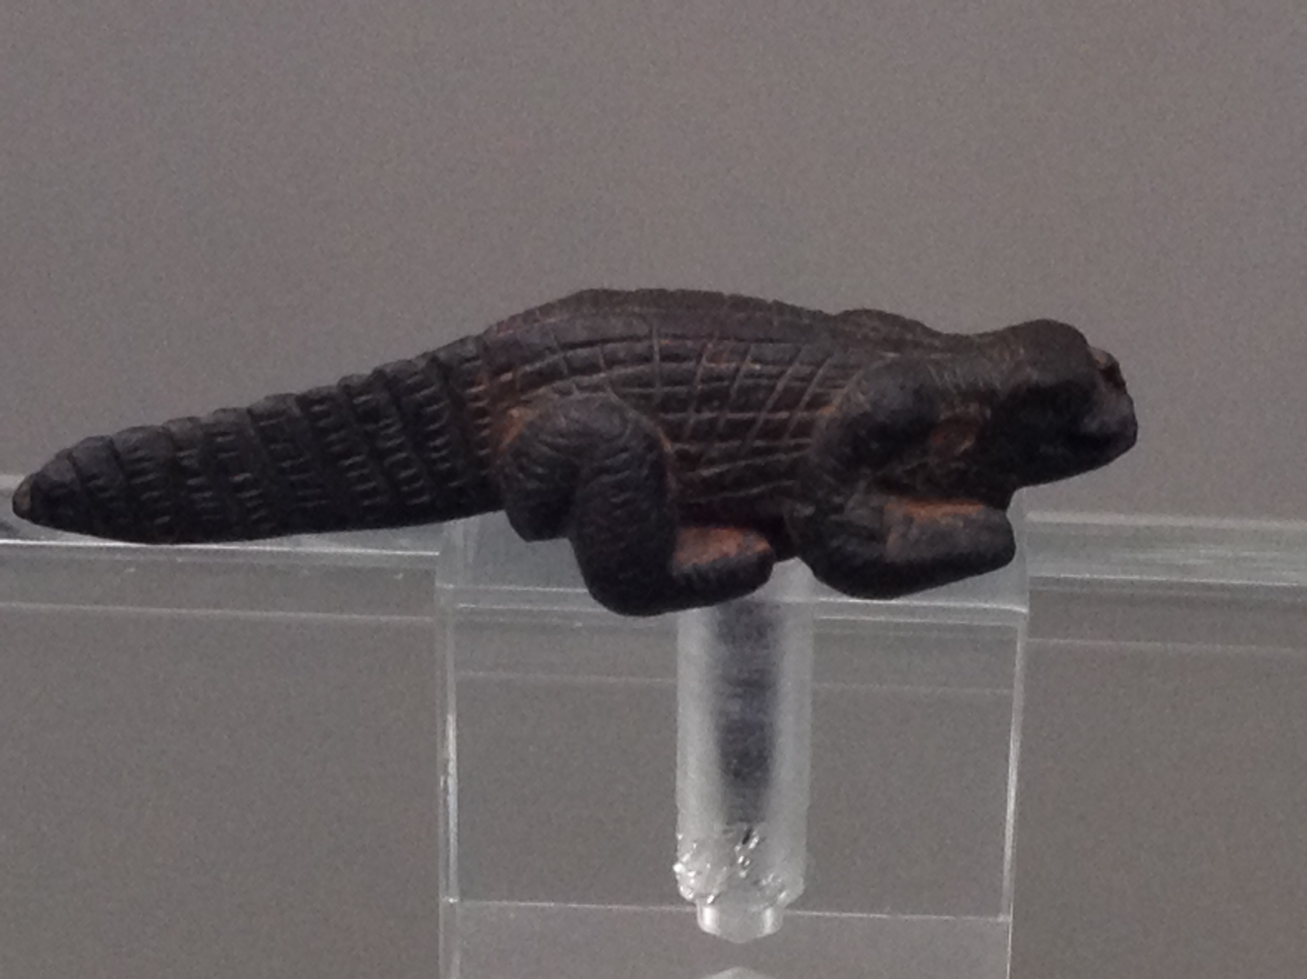
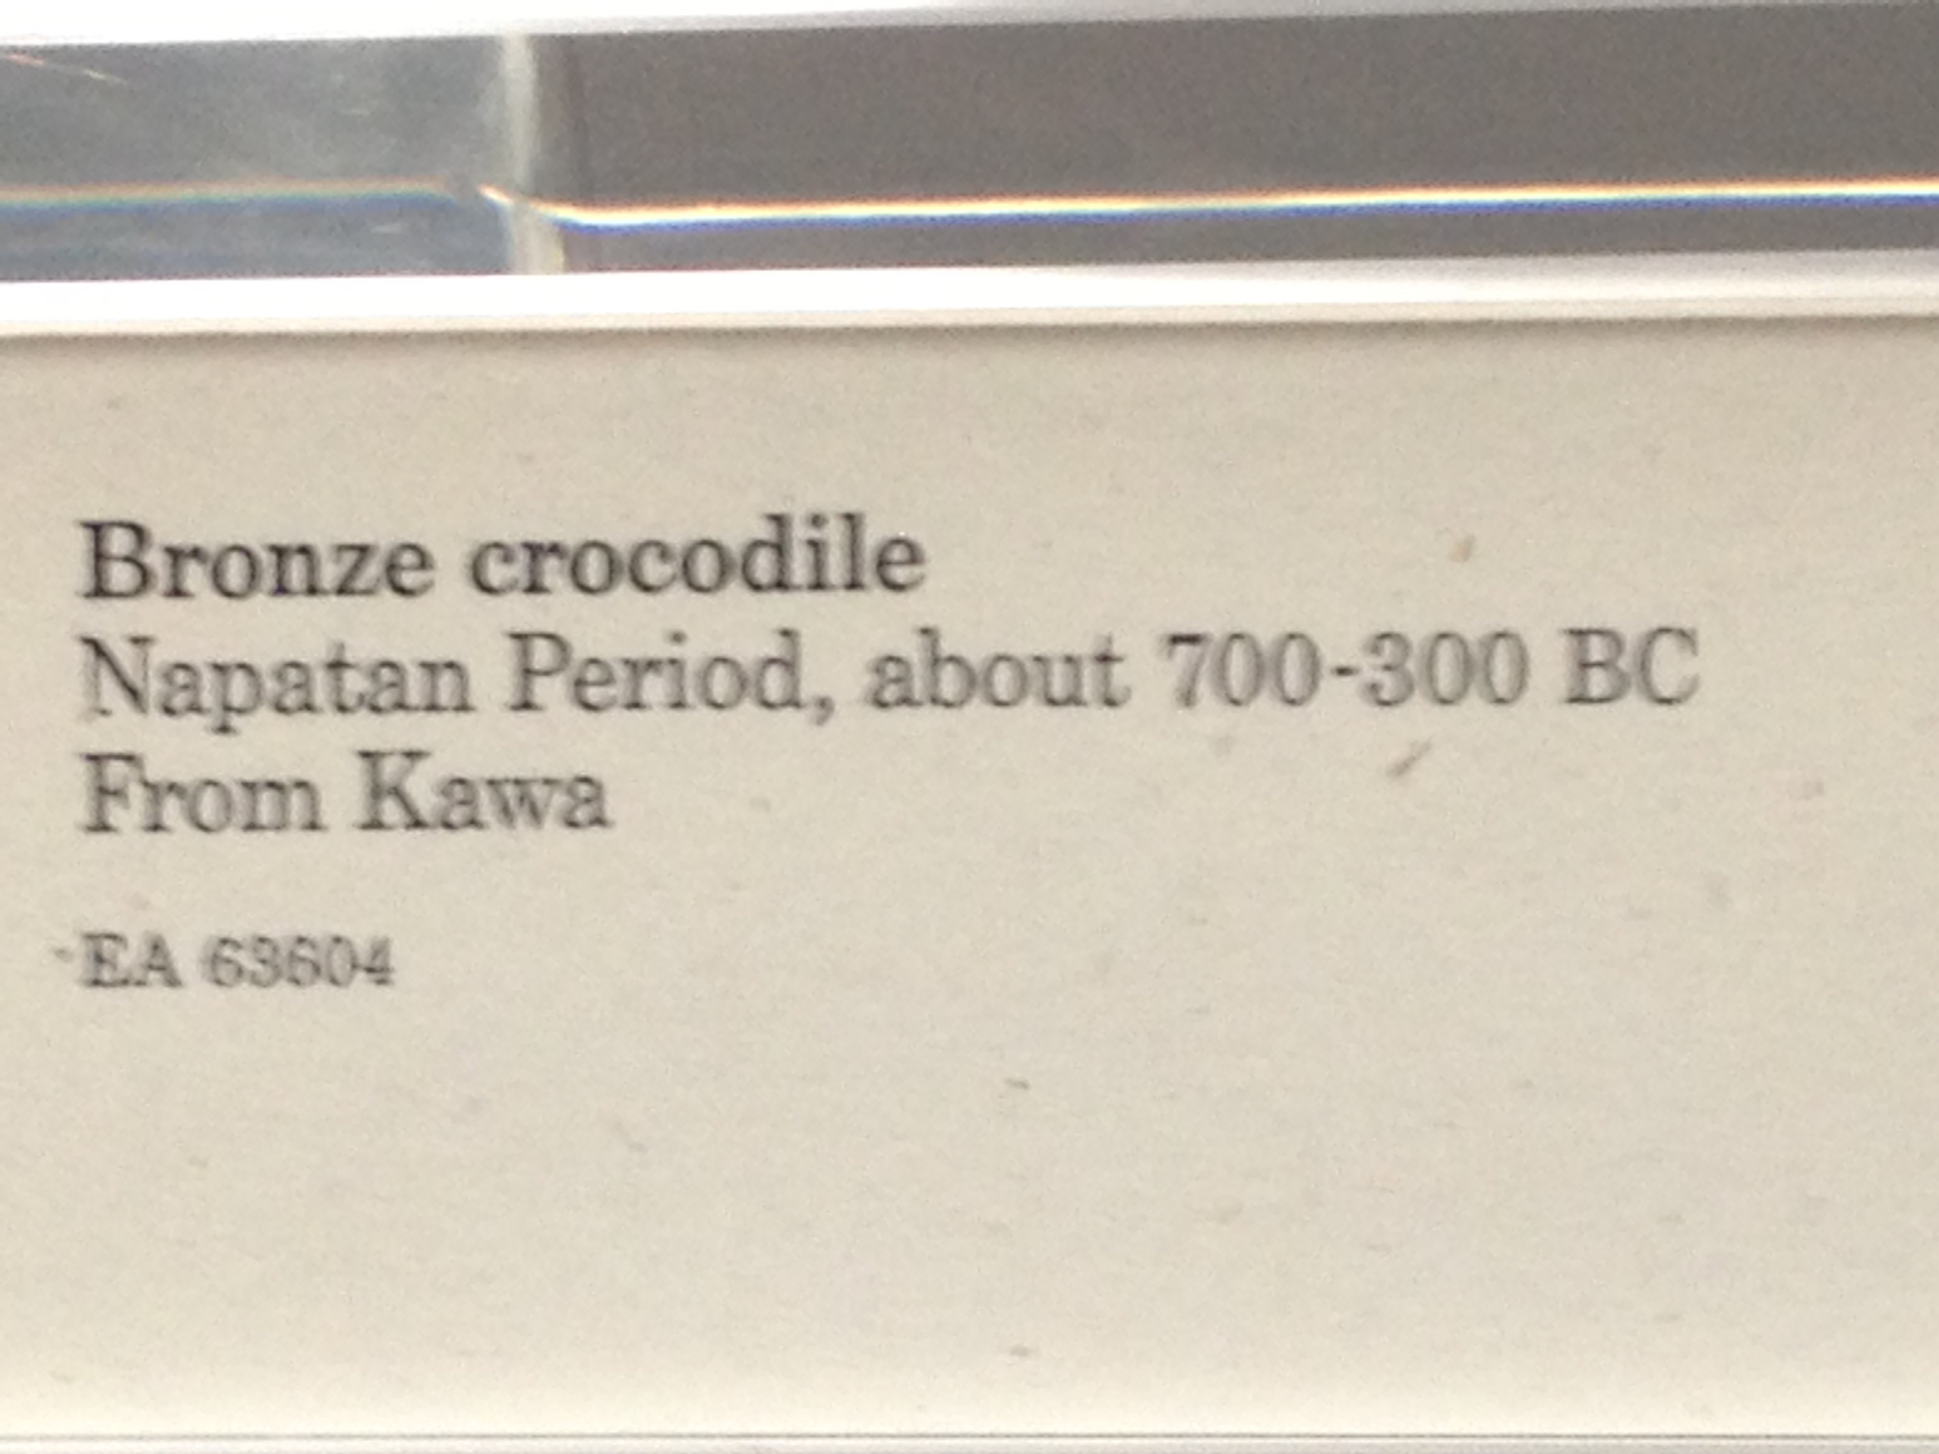
Bronze Crocodile Go Gators
Ancient Egypt

