Slide 1
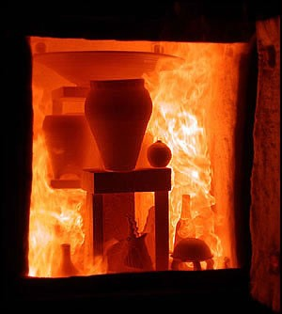
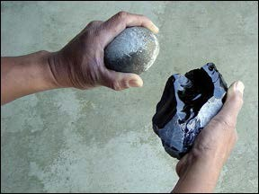
Humanized Ceramics
Firing Clay, Breaking Glass
IMOS
Intended for classroom instruction only.
Do not circulate.

Slide 2
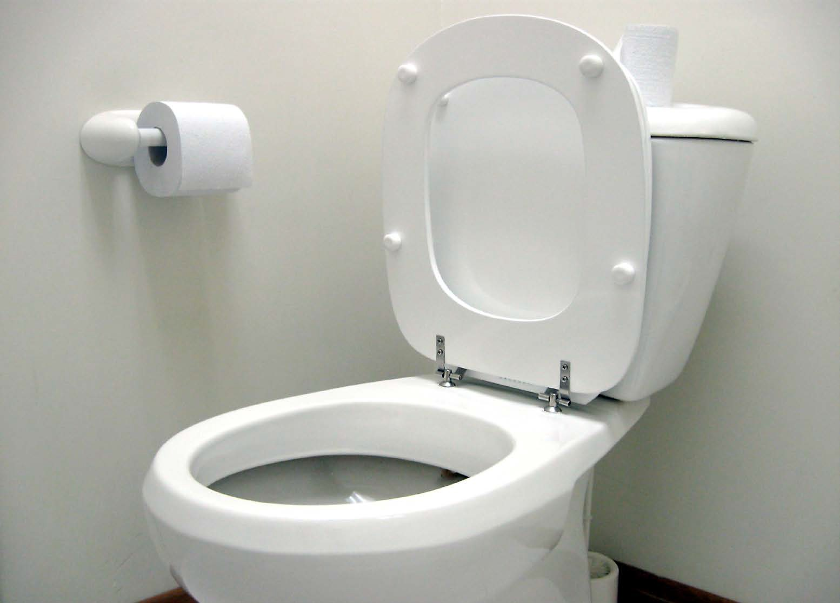
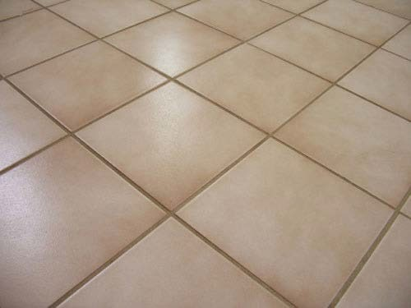
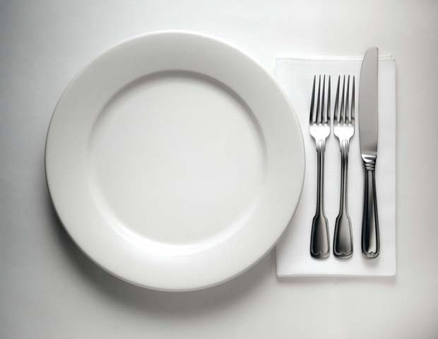
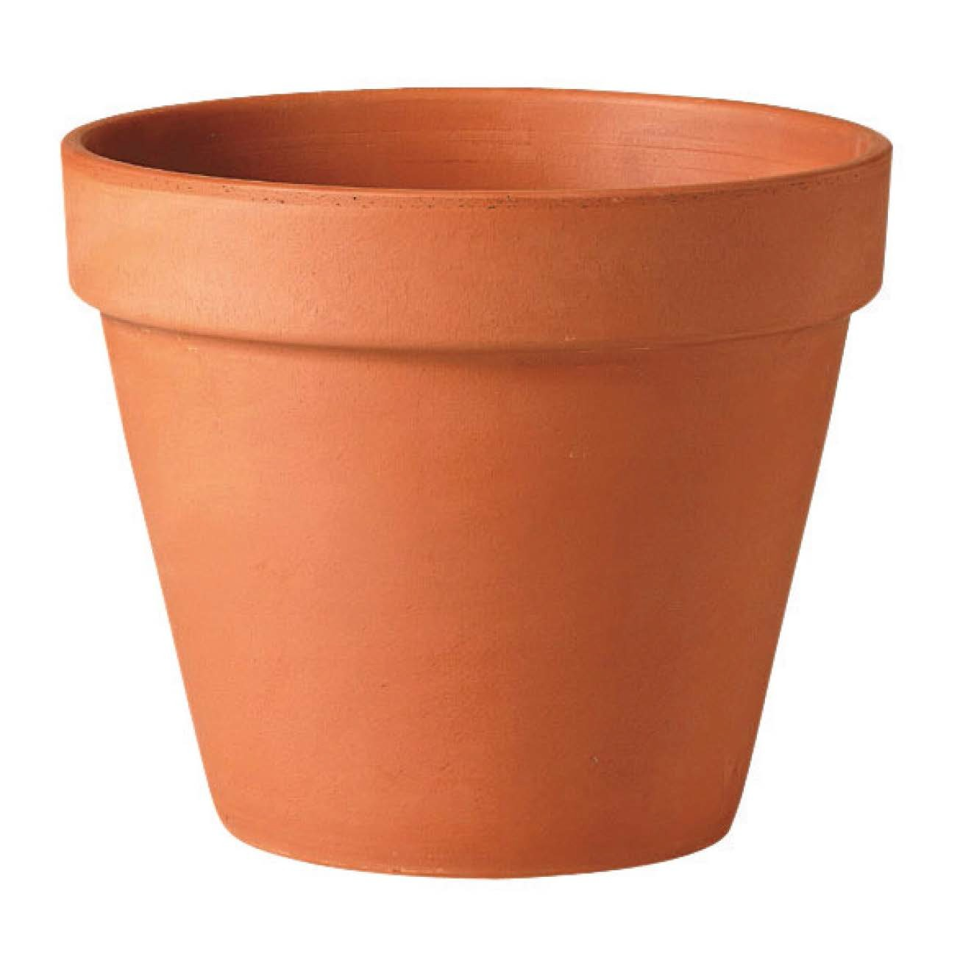
IMOS
Intended for classroom instruction only.
Do not circulate.

Slide 3
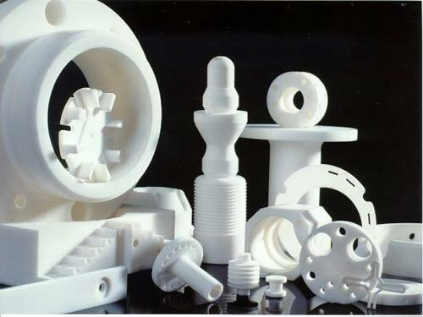
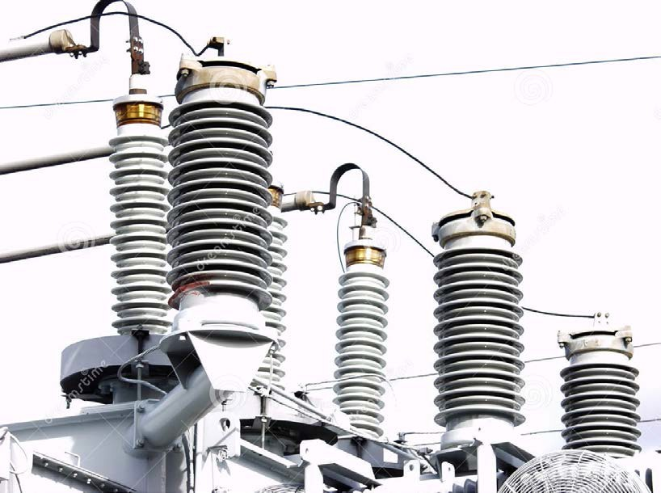
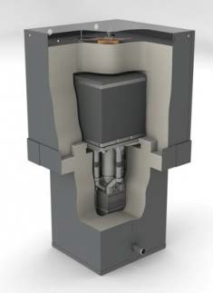
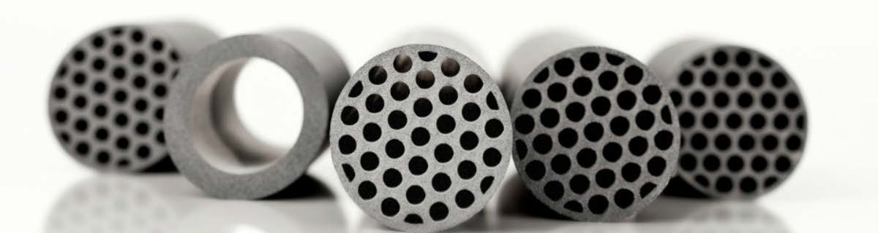
Technical or Functional Ceramics
IMOS
Intended for classroom instruction only.
Do not circulate.

Slide 4
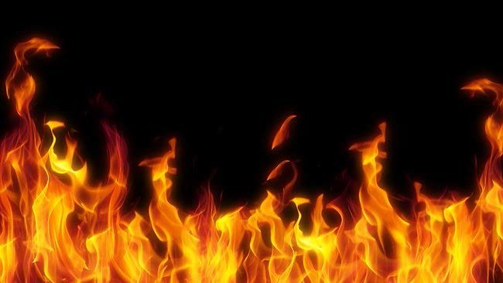
Ceramic: inorganic, nonmetallic, solid material, that varies from crystalline (with long-range structural order) to amorphous (lacking long-range structural order). Truly amorphous ceramics are glass, which is achieved through vitrification, a transformation of atomic/molecular structure requiring, for most clays, temperatures in excess of 1200 degrees C
IMOS
Intended for classroom instruction only.
Do not circulate.

Slide 5
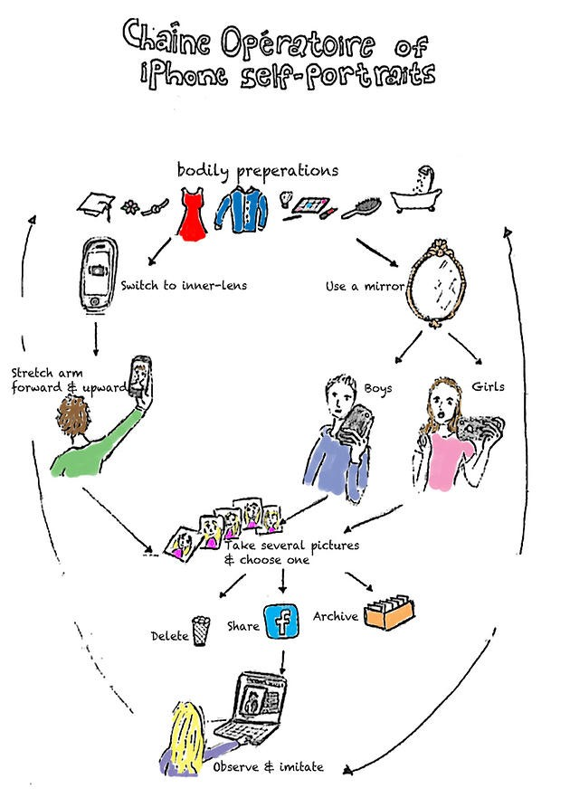
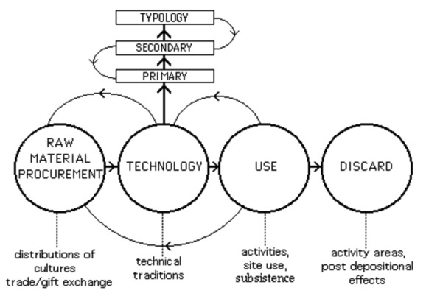
Operational Sequences
In control systems language, an operational sequence is an accounting of a system's procedures for start-up and shut- down, response to varying conditions, and certain scheduled operations.
How is this different than a tanglegram?
IMOS
Intended for classroom instruction only.
Do not circulate.
http://www.rogergrace.macmate.me/SARC/study/chaineoperatoire_files/chain.jpg
http://static.wixstatic.com/media/

Slide 6
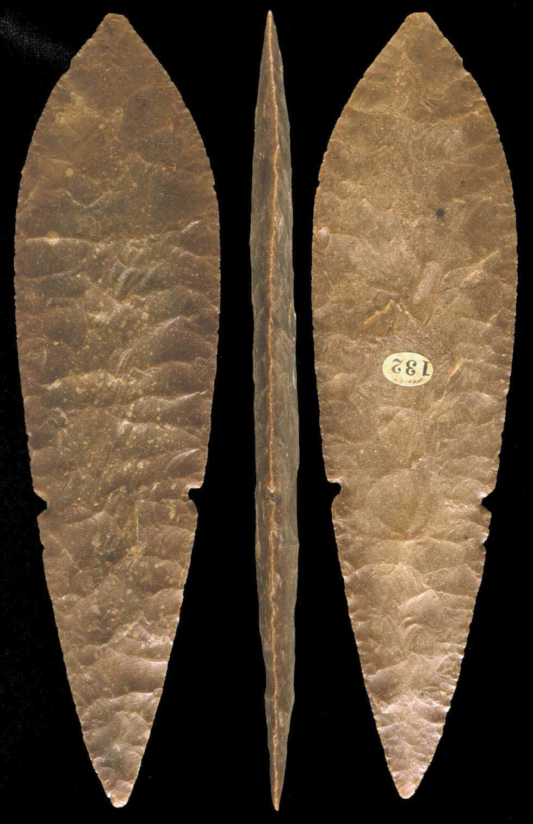
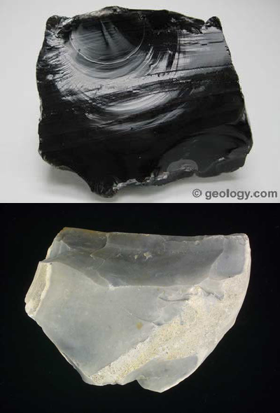
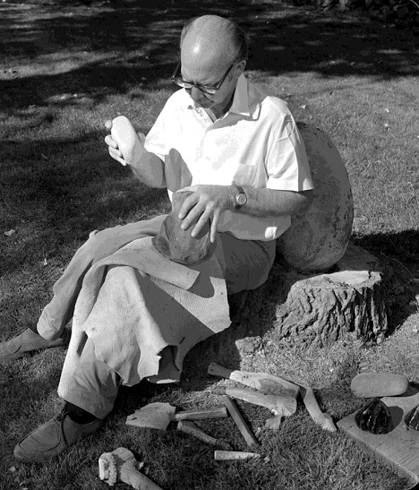
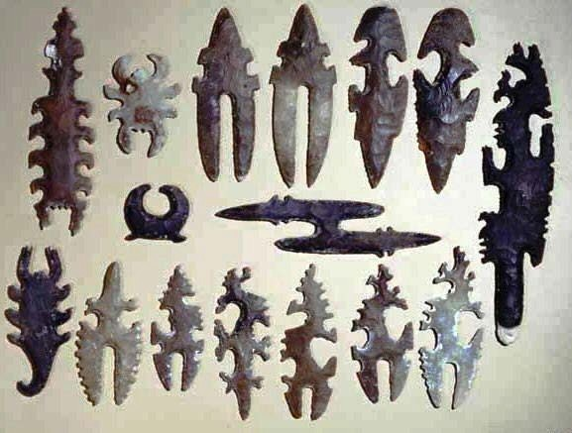
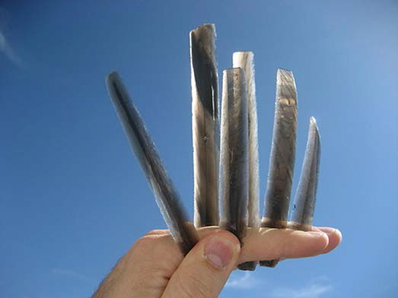
1. with the right kind of
rock
and the skill to apply controlled force
one can produce flakes and blades with sharp cutting edges
and an infinite variety of forms
obsidian
flint/chert
the late Don Crabtree, flintknapper extraordinaire
Flintknapping: Controlled Reduction of Glass-like Rock
IMOS
Intended for classroom instruction only.
Do not circulate.
Mesoamerican “eccentrics”
obsidian blades

Slide 7
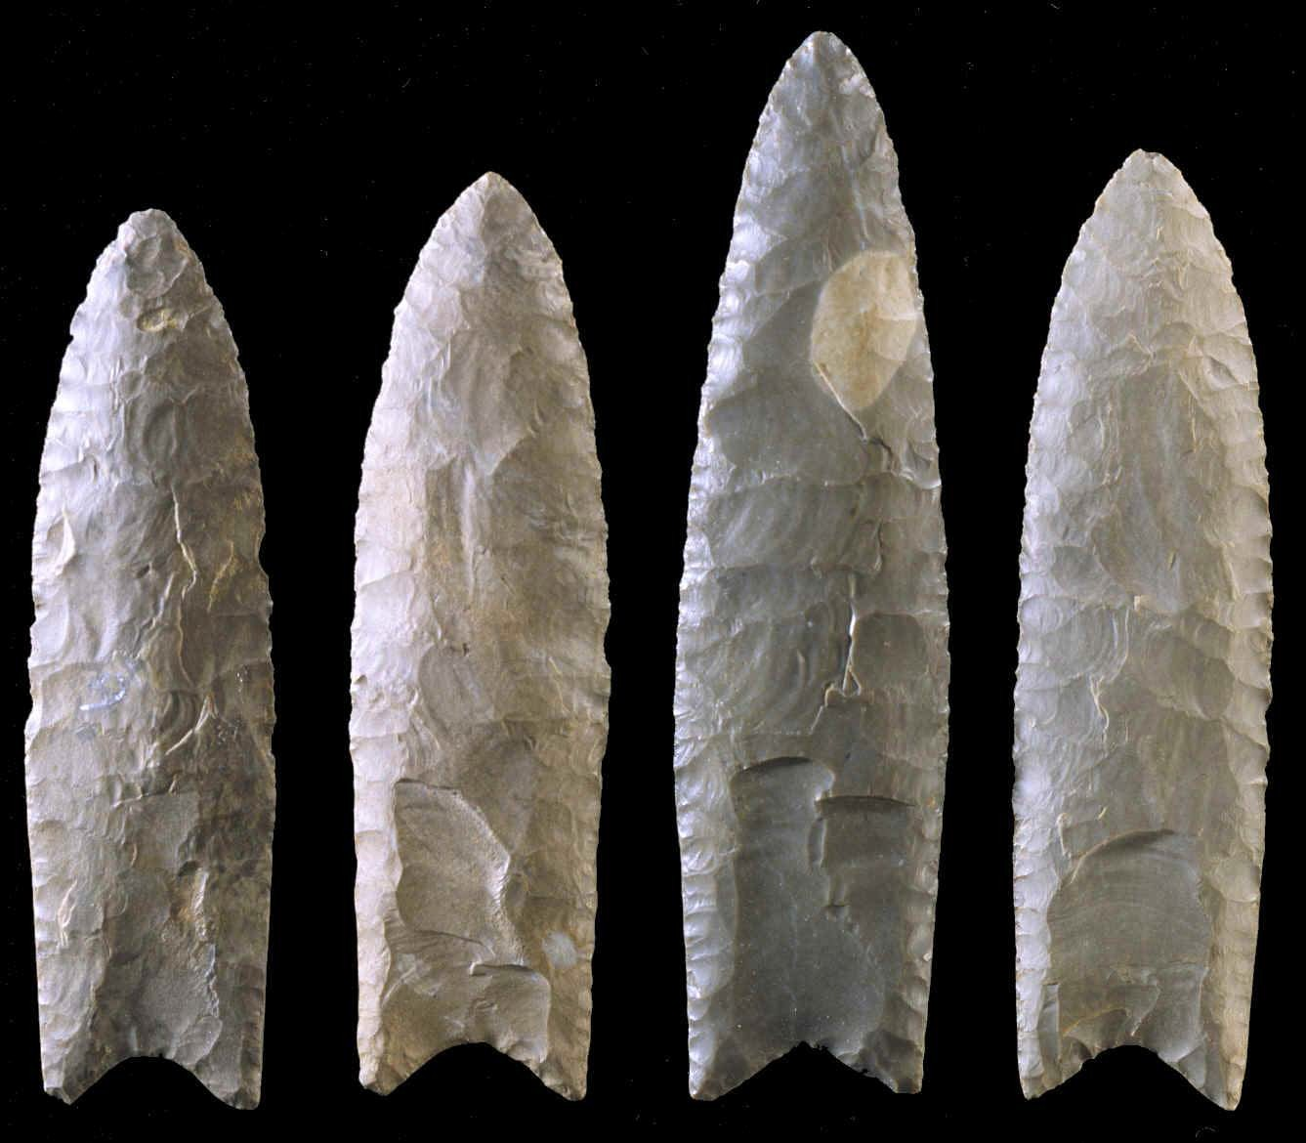
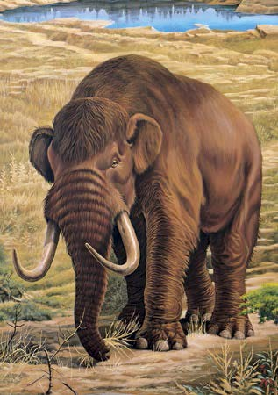
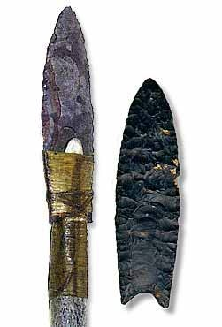
Examples of fluted Clovis points from eastern US
Clovis Culture
13,200-12,900 years ago across most of continental US
flute
flute
flute
IMOS
Intended for classroom instruction only.
Do not circulate.
flute

Slide 8
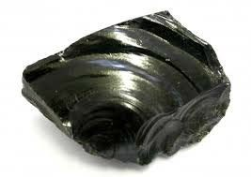
Step 1: Acquire Raw Material
Amorphous or Crytocrystalline Silicates
Properties of high-quality flintknapping raw material (Whittaker 1994:12-14)
Homogeneous (isotropic), fine-grained structure
Brittleness, thus subject to fracture
A bit of Elasticity, thus with some resistance to deformation
Includes materials with amorphous structure (glass, obsidian), and cryptocrystalline (or microcrystalline) structure, like chert and flint.
Conchoidal fracture
A range of rock quality was used in ancient times, but sources of the highest quality material were not pervasive, thus costly to acquire, and subject to control
Obsidian: volcanic glass
IMOS
Intended for classroom instruction only.
Do not circulate.

Slide 9

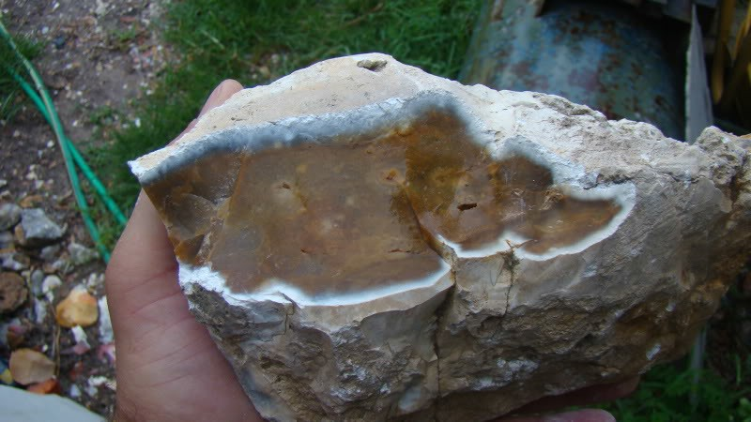
Step 2: Prepare Material for Transport
Eliminate useless mass, make portable
IMOS
Intended for classroom instruction only.
Do not circulate.

Slide 10
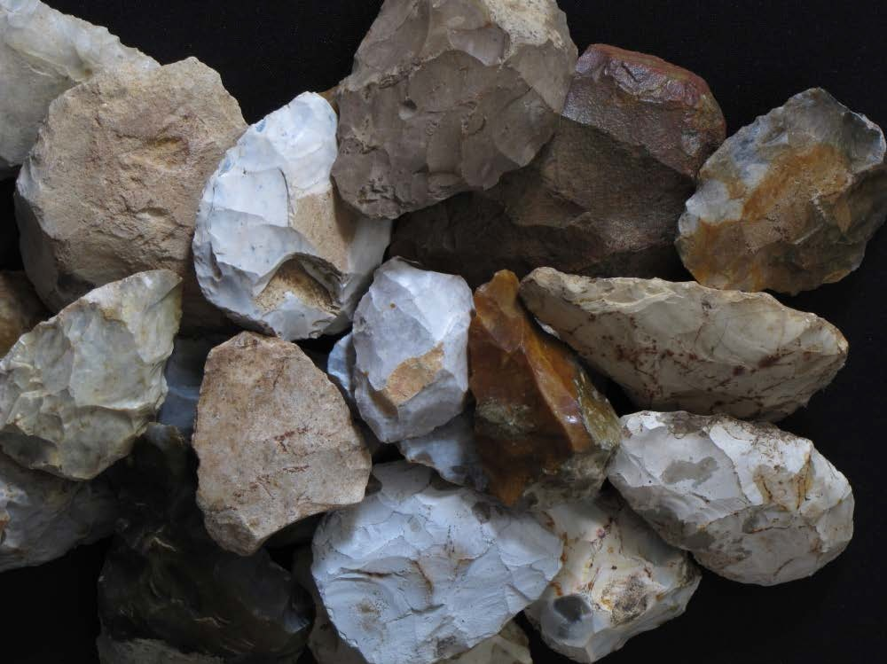
Step 3: Prepare Core for Reduction
Shape surface through planned, controlled application of force
Bifacial Reduction
Built into biface technology is the planned reduction of the core through successive functions or applications (operational sequence)
IMOS
Intended for classroom instruction only.
Do not circulate.

Slide 11
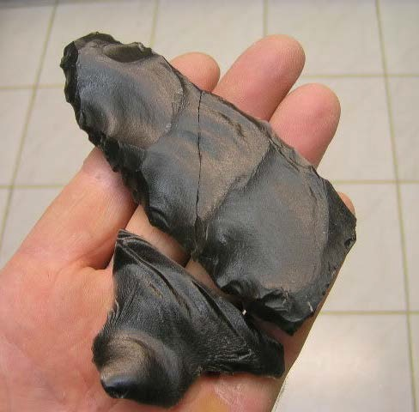
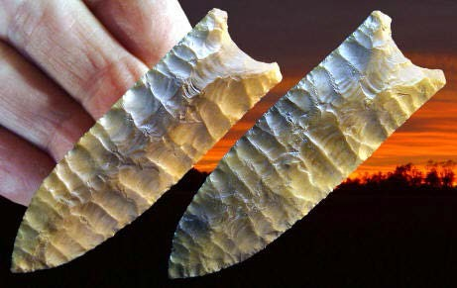
Step 4: Shape and Thin Biface
Achieve desired form and size
IMOS
Intended for classroom instruction only.
Do not circulate.
Left: thinning with “overshot” flakes
Above: midline termination of flakes to prepare for fluting

Slide 12
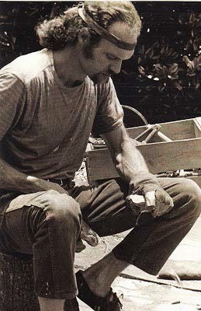
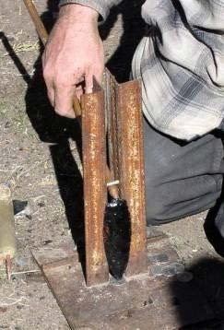
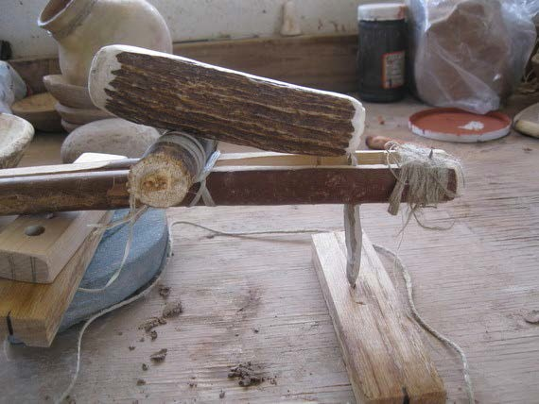
Step 5: Remove Flutes
Riskiest step… many failures
IMOS
Intended for classroom instruction only.
Do not circulate.

Slide 13
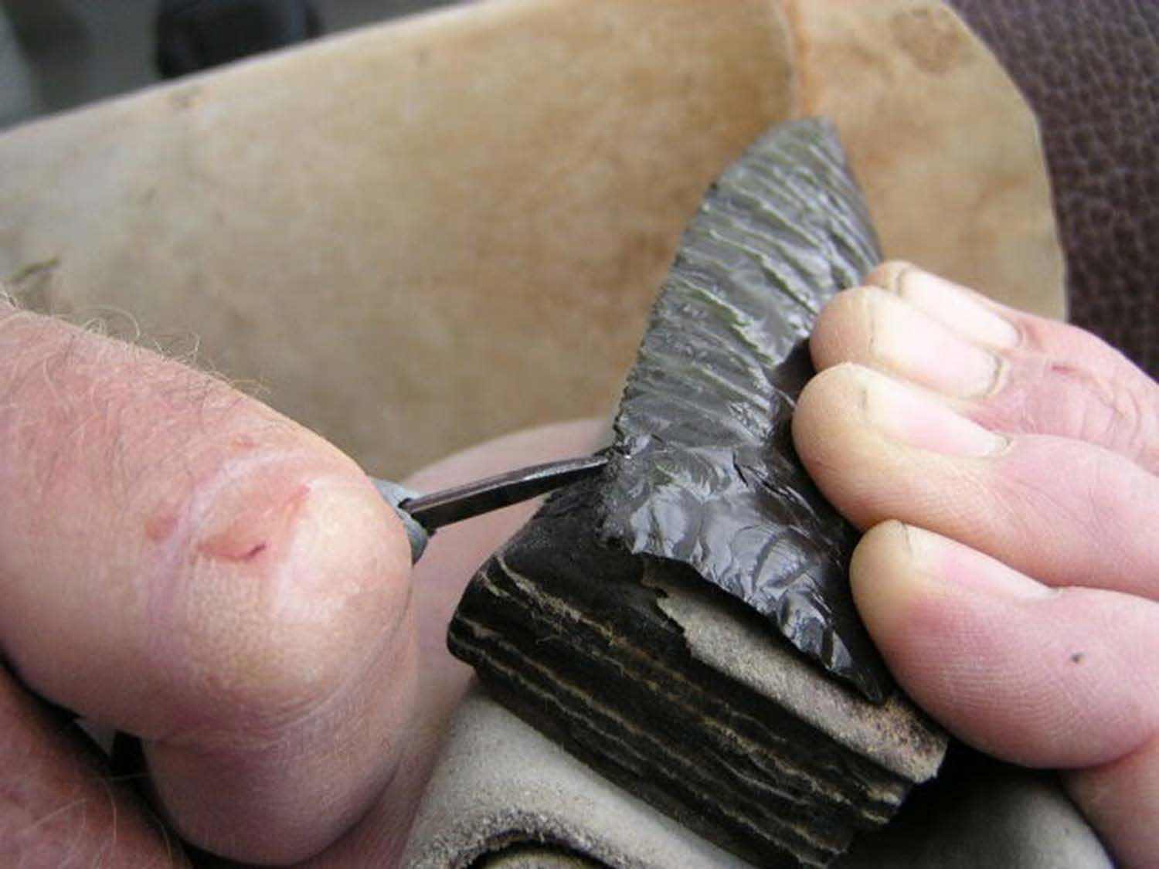
Step 6: Finish Edges
Time to apply pressure to make sharp, acute edges
IMOS
Intended for classroom instruction only.
Do not circulate.

Slide 14
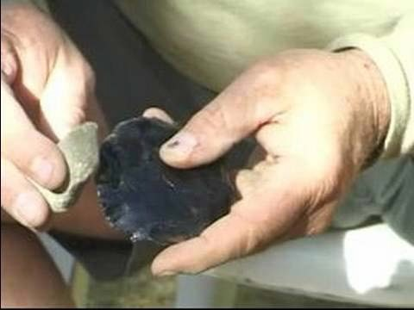
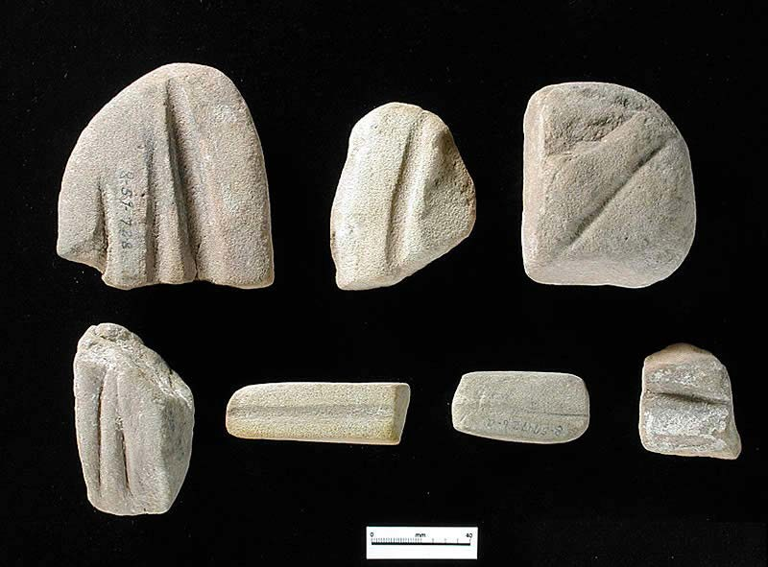
Step 7: Grind Basal Margins
Dull edges that will come in contact with material for attaching to handle
IMOS
Intended for classroom instruction only.
Do not circulate.

Slide 15
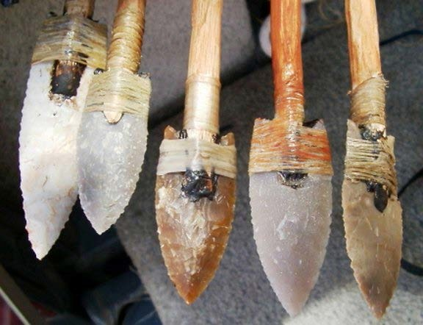
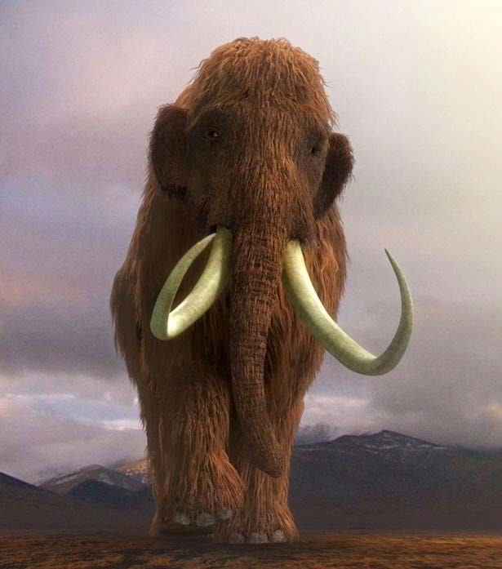
Step 8: Attach Point to Handle or Shaft
Need material for handle or shaft, plus binding material (cordage, glue)
Ready?
IMOS
Intended for classroom instruction only.
Do not circulate.

Slide 16
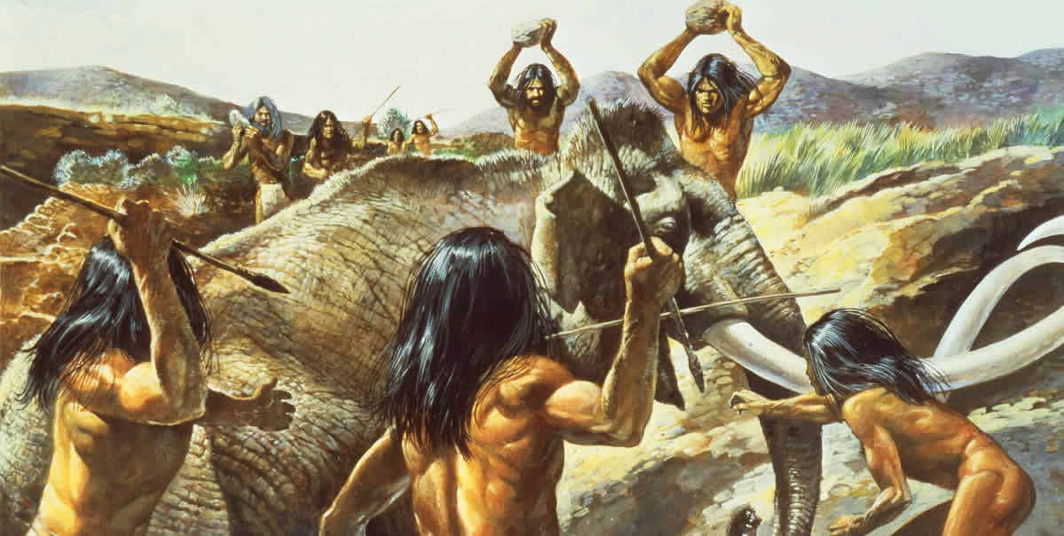
Hunting Mammoth was Communal Activity, and Resulted in “Surplus” to be Shared
IMOS
Intended for classroom instruction only.
Do not circulate.

Slide 17
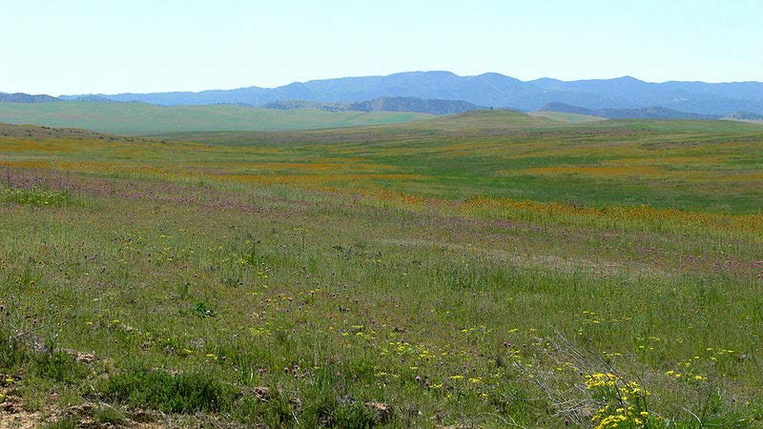
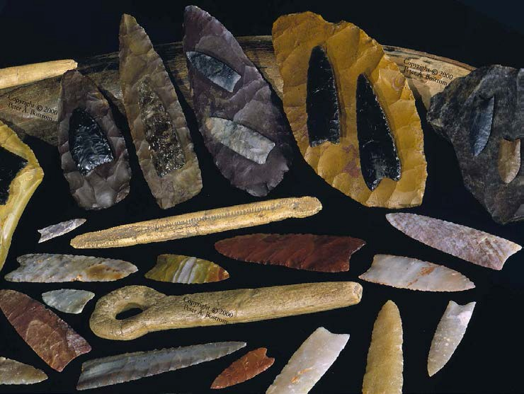
Raw Material Acquired from Hundreds of Miles Away
Did Clovis toolmakers have to cross into the “territory” of others to acquire rock?
IMOS
Intended for classroom instruction only.
Do not circulate.

Slide 18
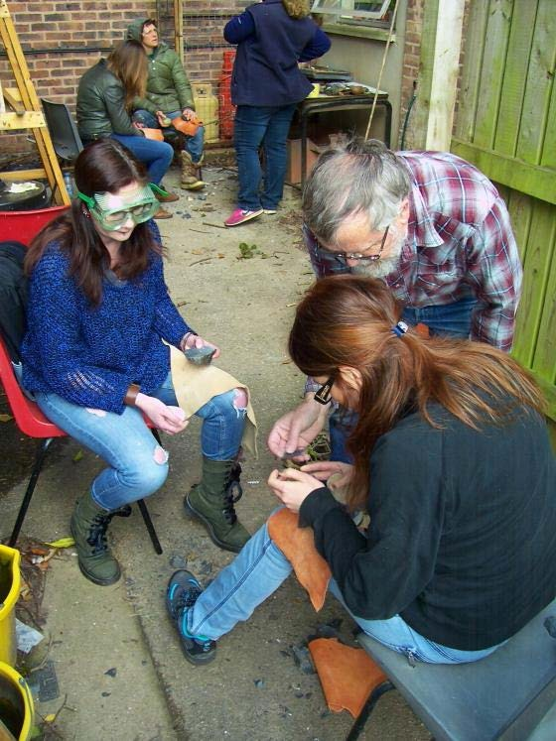
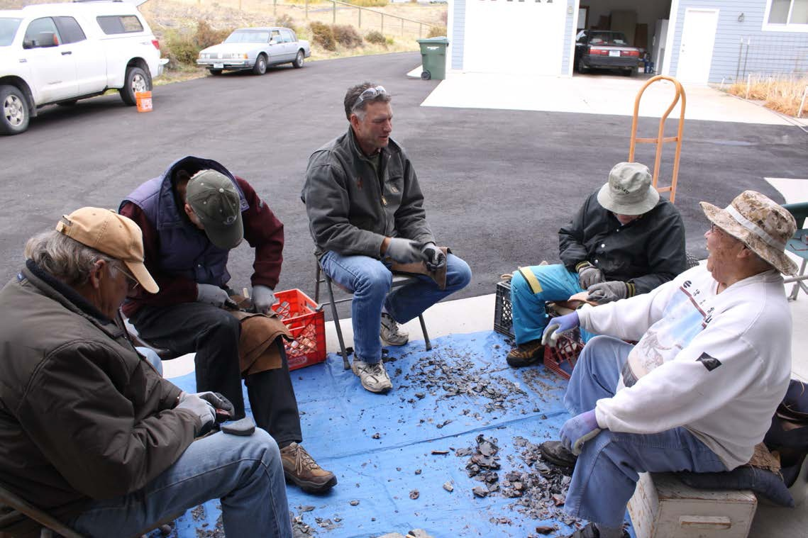
Communities of Practice
Learning is Social
IMOS
Intended for classroom instruction only.
Do not circulate.

Slide 19
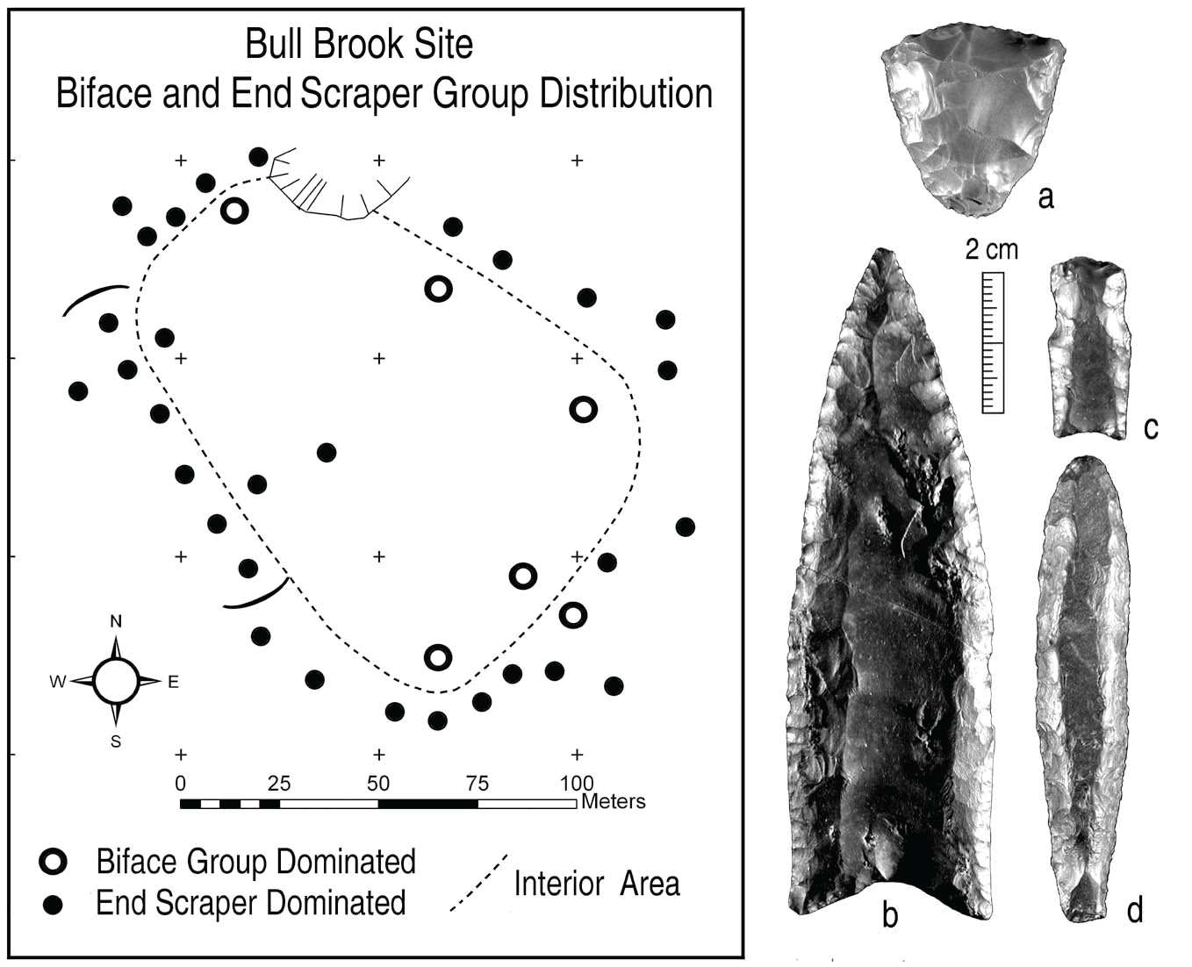
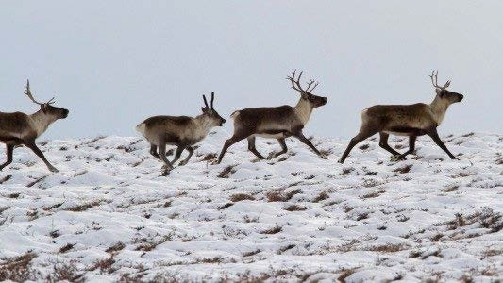
Riskiest Step (Fluting) Taken under Guidance of Specialist?
Sexual Division of Labor in Spatial Arrangement of Tasks?
Bull Brook site, north of Boston, MA: clusters of fluted bifaces, end scrapers, and other tools in oval array across area the size of two football fields; Brian Robinson (Univ. of Maine) interprets as highly structured aggregation settlement associated with fall/winter caribou hunt.
IMOS
Intended for classroom instruction only.
Do not circulate.

Slide 20
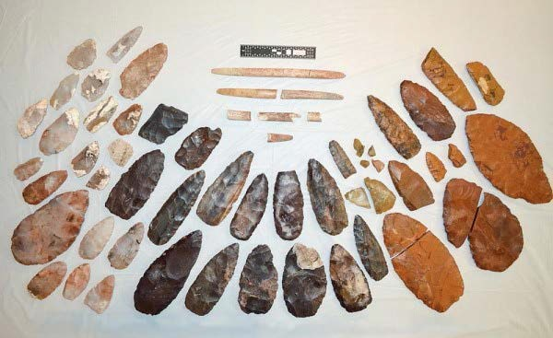
Clovis Caching
Ritual deposits, occasionally with human burials
IMOS
Intended for classroom instruction only.
Do not circulate.

Slide 21
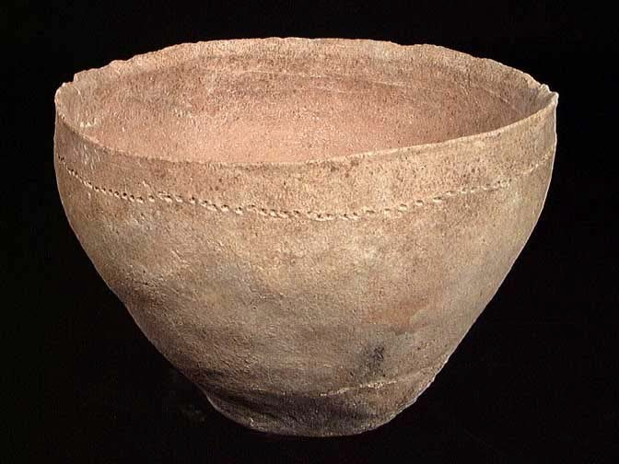
Early Cookware
Earthenwares, Terra Cottas, Subceramics
Better at insulating than conducting heat
Problem: how to develop technology that is a better conductor of heat while also resistant to thermal shock.
Why? Need to unlock the nutritional potential of foods that require prolonging boiling
IMOS
Intended for classroom instruction only.
Do not circulate.

Slide 22
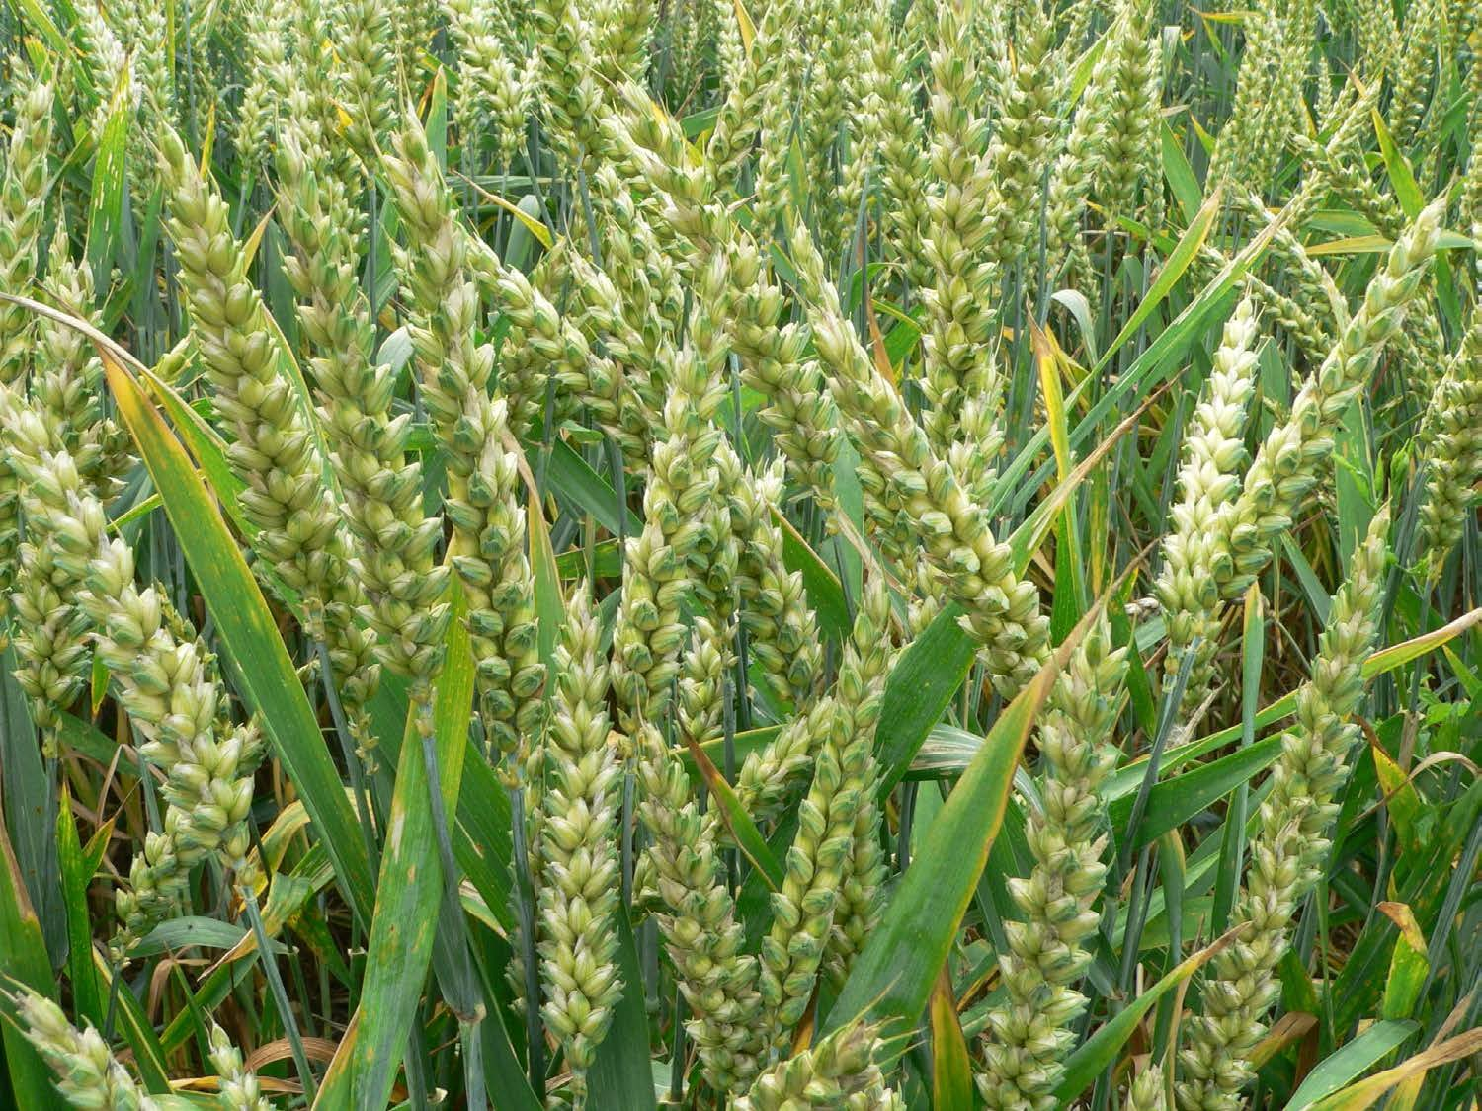
Wild Grasses
Basis for early farming, beginnings of civilization
Problem: they require prolonged boiling to maximize nutritional value
IMOS
Intended for classroom instruction only.
Do not circulate.

Slide 23
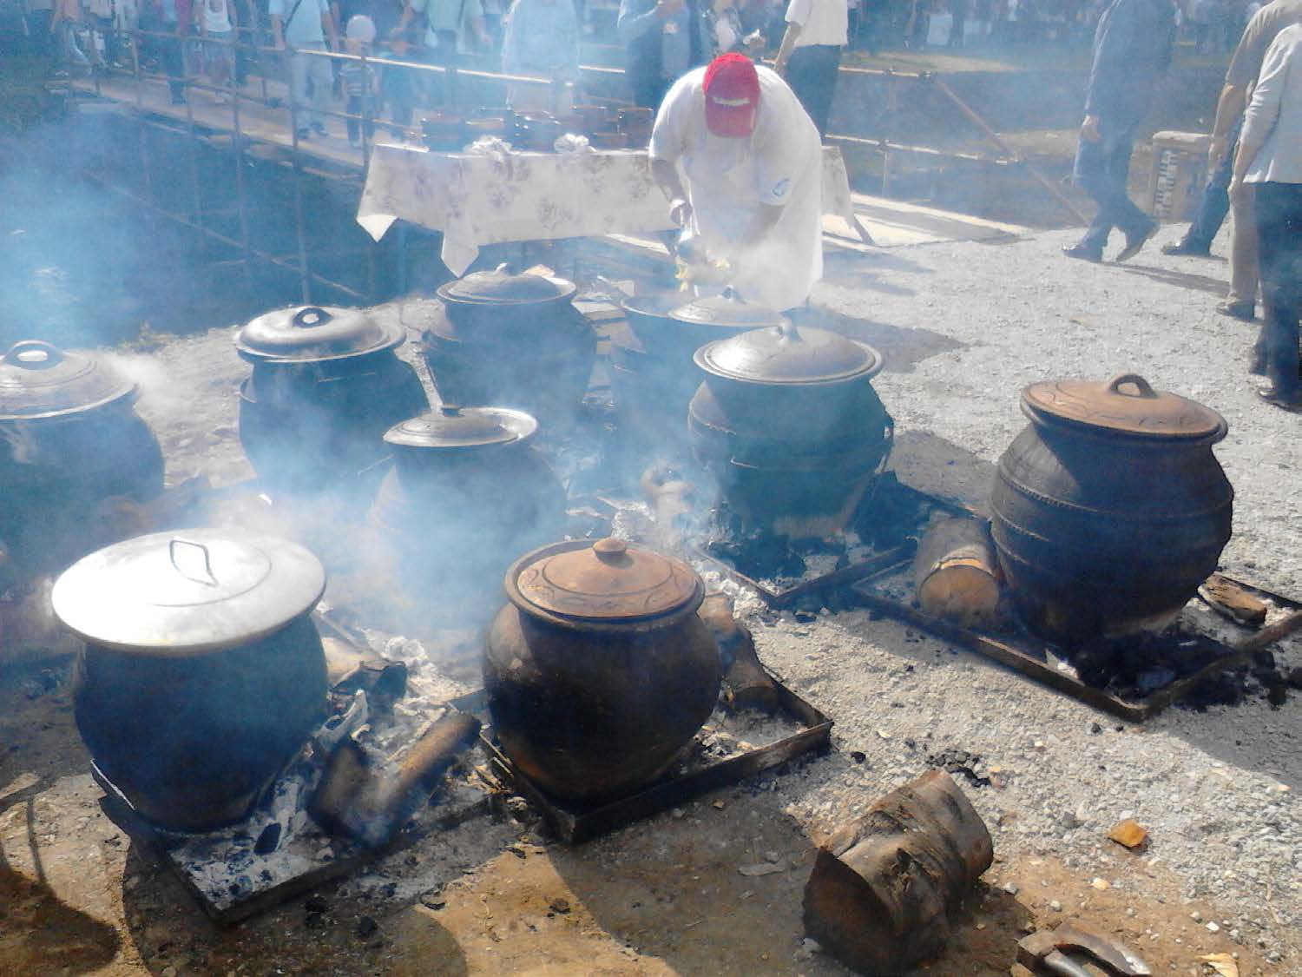
The Ideal Cook Pot?
IMOS
Intended for classroom instruction only.
Do not circulate.

Slide 24
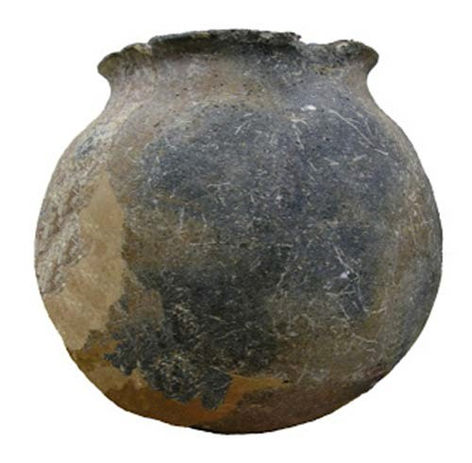
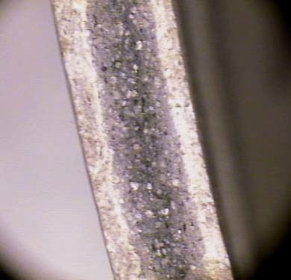
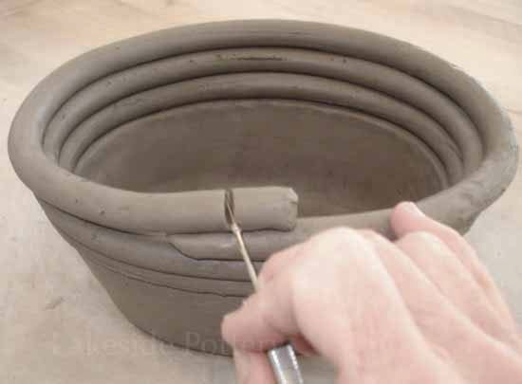
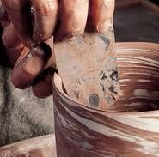
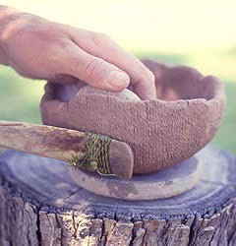


IMOS
Intended for classroom instruction only.
Do not circulate.

Slide 25

Kilns:
Achieving Temperatures of Vitrification
Chinese climbing kilns like the one shown here date back as early as 5th
century A.D.
(http://www.lowtechmagazine.com/ 2009/10/hoffmann-kilns-brick-and-
tile-production.html)
IMOS
Intended for classroom instruction only.
Do not circulate.

Slide 26



Intensification: Producing More, but at Higher Per-Unit Costs
(and possibly lots of hidden costs and unforeseen consequences)
IMOS
Intended for classroom instruction only.
Do not circulate.

