Slide 1




This session will use an online poll.
Network: Sheraton Meeting
Password: f17hotel
www.mrs.org/vote
Materials Needs for Energy
Sustainability by 2050
The Role of the Circular Materials Economy

Slide 2


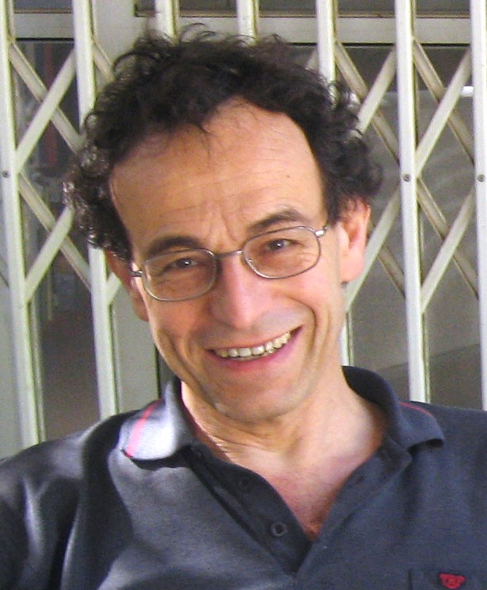
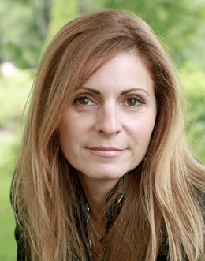
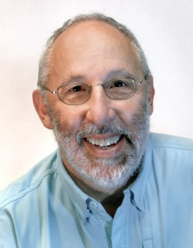



Editors-in-Chief
David Cahen
Weizmann Inst., Israel
Elizabeth A. Kócs
UI Chicago, USA
David S. Ginley
NREL, USA
Associate Editors
Kristen Brown
ComEd, USA
Sydney Kaufman
State Sen. Begich (AK), USA
Pabitra K. Nayak
Oxford, UK

Slide 3

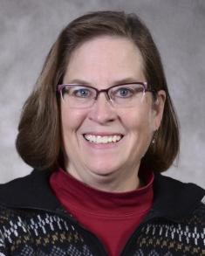

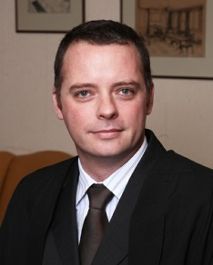
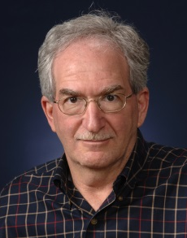
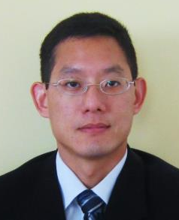
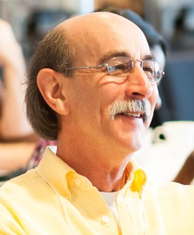
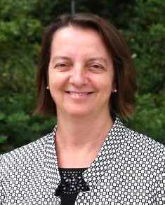

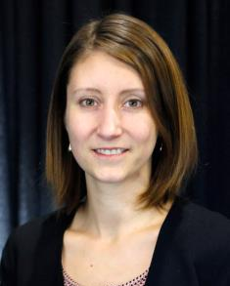

Libby Kupp
POC Chair
Penn State, USA
Ivana Aguiar
Univ. Rep., Uruguay
Jonathan Cullen
Cambridge, UK
Martin Green
NIST, USA
Anthony Ku
NICE, USA/China
Richard A. Souza
MRS Manager,
Edu. & Outreach
Julie Schoenung
UC Irvine, USA
Margeaux Wallace
GE Global Res., USA
Ashley White
Berkeley Lab, USA

Slide 4
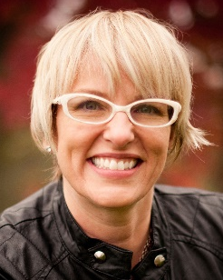
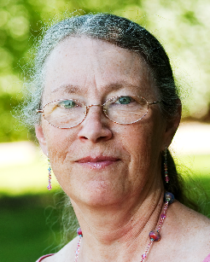
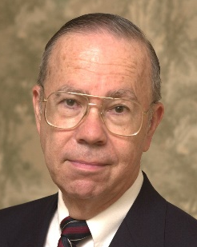
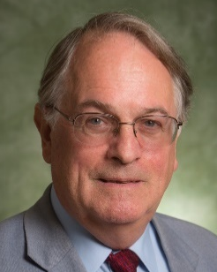
Panelists
Outline
Is our quest to invent new materials and more complex products at odds with achieving energy sustainability?
Can we pursue economic growth and still deliver materials and products sustainably?
What opportunities does a shift to a circular economy bring to materials research?
Carolyn Duran
Intel Corporation
Linda Gaines
Argonne National Lab
Thomas E.
Graedel
Yale University
M. Stanley Whittingham
Binghamton Univ.

Slide 5
www.mrs.org/vote
Network: Sheraton Meeting
Password: f17hotel

Slide 6
Where are you from?
      United States
      Africa
      Asia
      Europe
      Oceania
      Other North or Central America
      South America
www.mrs.org/vote

Slide 7
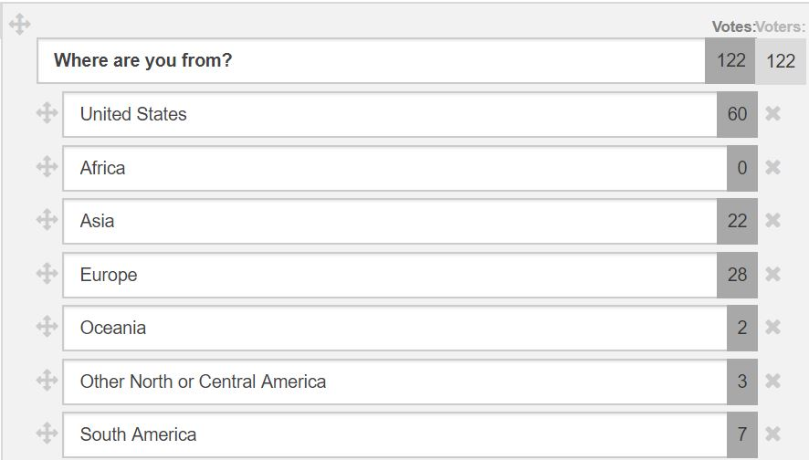

Notes:
LiveSlide
http://www.mrs.org/poll-results

Slide 8
What type of institution do you represent?
      University
      Industry
      Government-sponsored lab
      Government agency
      Other
www.mrs.org/vote

Slide 9
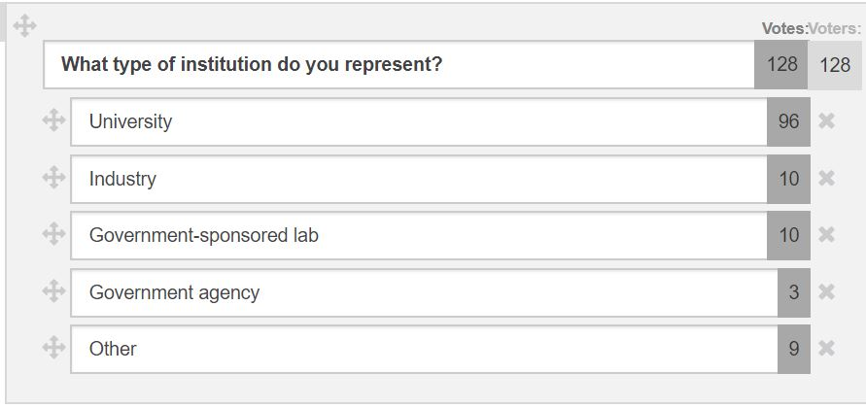
Notes:
LiveSlide
http://www.mrs.org/poll-results

Slide 10
What is your career stage?
          Student
          Postdoc
          Early career
          Mid career
          Late career
www.mrs.org/vote

Slide 11
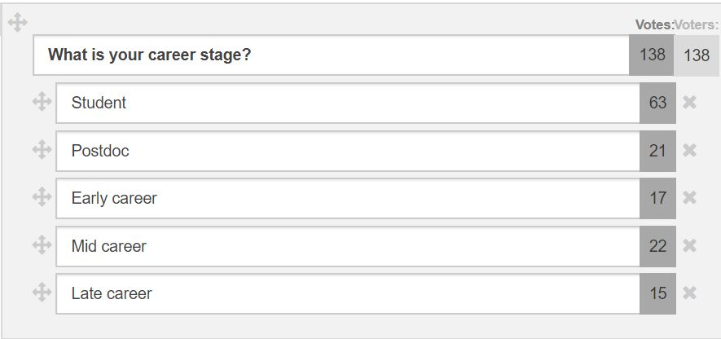
Notes:
LiveSlide
https://www.mrs.org/poll-results

Slide 12
How would you rate your knowledge of the circular economy?
          I’ve never heard of it
          I’m a beginner
          I’ve read quite a bit
          I’m an expert
www.mrs.org/vote

Slide 13
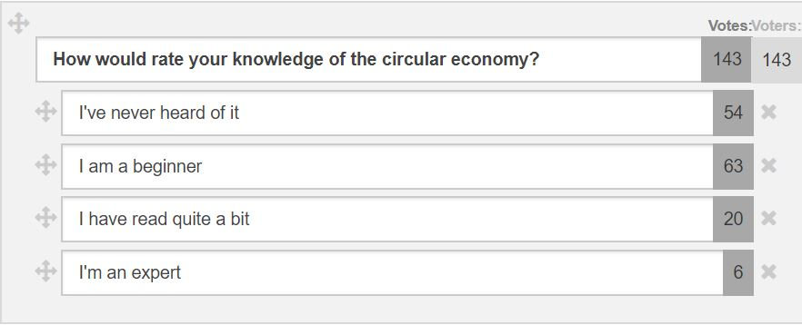
Notes:
LiveSlide
http://www.mrs.org/poll-results

Slide 14
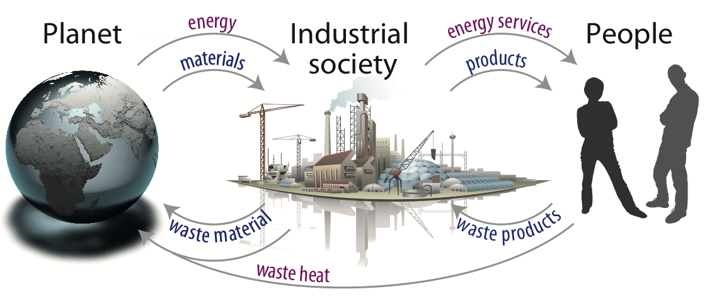
“A modern industrial society can be viewed as a complex machine for
degrading high-quality energy into waste heat while extracting the energy needed for creating an enormous catalogue of goods and services” Claude Summers (1971)

Slide 15
How many mobile phones do you own, including those sitting at home in a drawer?
            None
            1
            2-3
            4 or more
www.mrs.org/vote

Slide 16
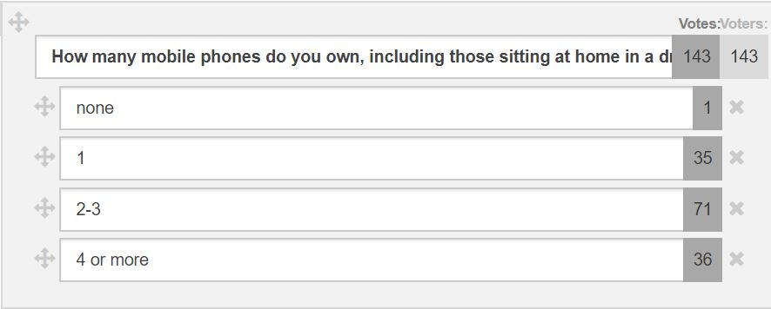
Notes:
LiveSlide
http://www.mrs.org/poll-results

Slide 17
LINEAR MODEL
CIRCULAR MODEL

Slide 18
Key Questions
How can we meet the growing demand for materials in a sustainable way, with fewer raw materials, less energy, and reduced environmental impact, all while maintaining economic growth?
Can a circular economy be implemented in a practical, cost-effective, and environmentally friendly way?
What opportunities does a shift to a circular economy bring to materials research?

Slide 19
Panelists
Carolyn Duran
Intel Corporation
Linda Gaines
Argonne National Lab
Thomas E.
Graedel
Yale University
M. Stanley Whittingham
Binghamton Univ.

Slide 21
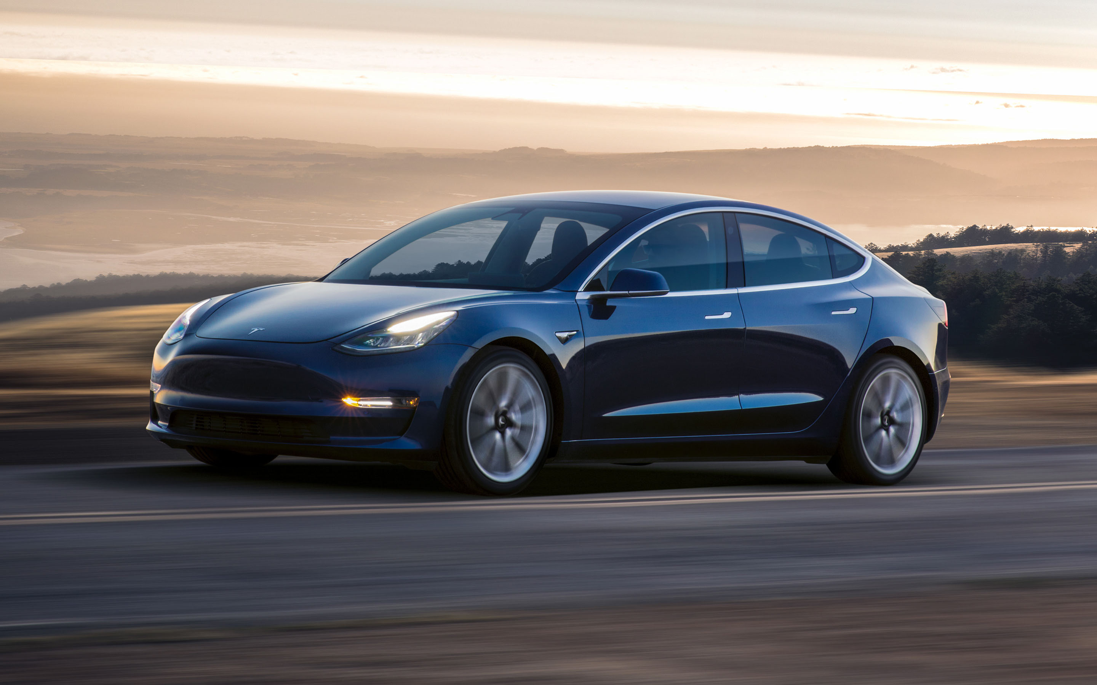

Slide 22
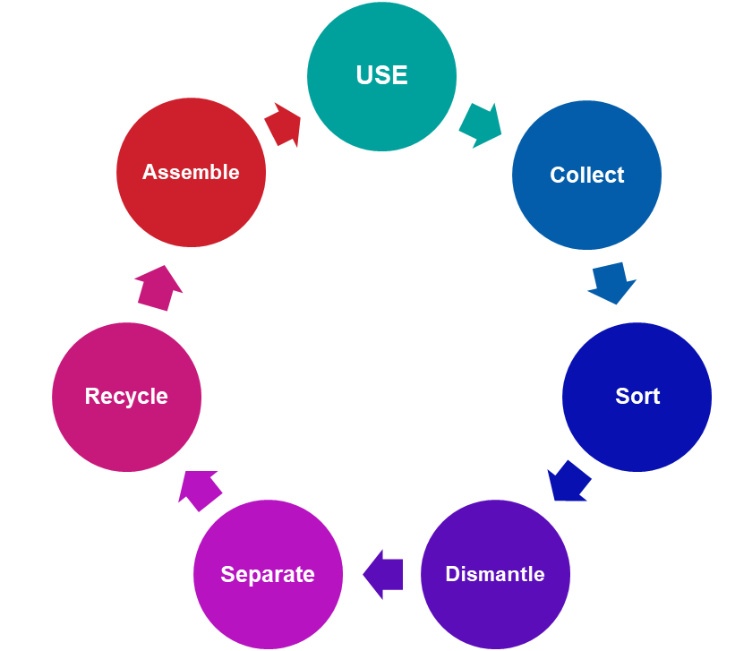

How can we get li-ion batteries recycled?
We need to address the whole product cycle.
Collection of phone batteries is a problem
  Small but numerous
    EPA says ~10% come back
  Collection of vehicle batteries should be easy
Disassembly is difficult
  Different pack and cell designs
  Neither device nor cell is designed to be taken apart
Phone battery material recovery would yield Co
  Value of Co per phone <$0.25
  Vehicle batteries use much less Co
    Need to recover cathode per se
Buyers of recycled material will require:
  Consistent high quality
  Assured sufficient quantity
Notes:
Acid/base could be used to precipitate desired elements
Especially important for cathodes with low elemental values
Could think about anode materials, too

Slide 23

NEED TO SOLVE THE SUSTAINABILITY ISSUE OF COBALT
Each phone contains 4-10 g of cobalt (each Tesla contains ~ 500 kg of Ni + Co)
Mining Issues:
  Batteries driving price of Cobalt
  Child labor issues with Cobalt mining in the Congo
First need to get small devices voluntarily returned for recovery
  Large systems need to be mandated
    Government should play key roles
    Even more important when the valuable Cobalt content is reduced (replaced by Ni and/or Mn)
  Safety is a key issue in dumps and recycling (e.g. accidents in Pb acid recycling)
Second need to develop technologies to recover all components
  Ideally in a form that the can be re-used essentially as is
    Research underway on cathode material recovery and “re-activation” (= add Lithium + firing)
  Rest of cell might be used as enriched ore: e.g. Copper, Aluminum, Lithium
Notes:
Acid/base could be used to precipitate desired elements
Especially important for cathodes with low elemental values
Could think about anode materials, too

Slide 24
Is recycling always the
best option?
          Always
          Depends
          Never
www.mrs.org/vote

Slide 25
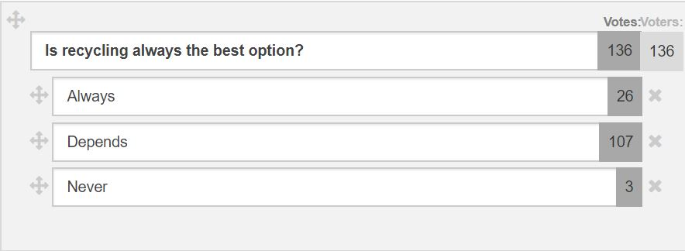
Notes:
LiveSlide
http://www.mrs.org/poll-results

Slide 26
Is our quest to invent new materials and more complex products at odds with achieving energy sustainability?
          Yes
          Maybe
          No
www.mrs.org/vote

Slide 27
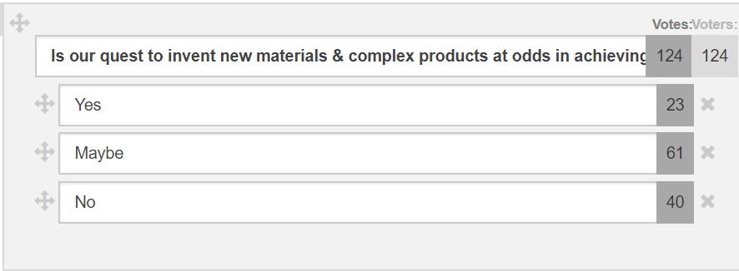
Notes:
LiveSlide
http://www.mrs.org/poll-results

Slide 28
Can we pursue economic growth and still deliver materials and products sustainably?
          Definitely
          Probably
          Possibly
          Unlikely
www.mrs.org/vote

Slide 29
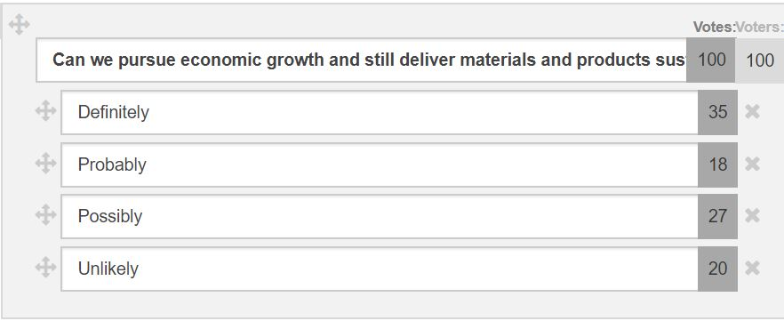
Notes:
LiveSlide
http://www.mrs.org/poll-results

Slide 30
Will the circular economy play an important part in driving materials science research directions?
          Definitely
          Probably
          Possibly
          Unlikely
www.mrs.org/vote

Slide 31
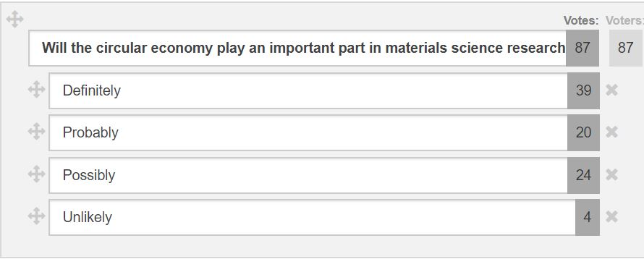
Notes:
LiveSlide
http://www.mrs.org/poll-results

Slide 32
How would you describe this panel session?
        Great, I learned a lot
        Inspiring
        Interesting
        Somewhat useful
        Not useful
www.mrs.org/vote

Slide 33
Notes:
LiveSlide
http://www.mrs.org/poll-results

Slide 34



Thank you for
your participation!

Slide 35
Notes:
LiveSlide
https://www.mrs.org/poll-results

Slide 36
Notes:
LiveSlide
https://www.mrs.org/poll-results

Slide 37
Notes:
LiveSlide
https://www.mrs.org/poll-results

